Slide 1

Reinforcement Learning with Hybrid Clustering for Energy Optimization in Wireless Sensor Network
Presented By
Shubham Kumar
Electronics & Communication Engineering
Guided By
Prof. Bharat Gupta
Electronics & Communication Engineering
Department of Electronics and Communication Engineering National Institute Technology
Patna 800005

Slide 2
Presentation Outline
Background – context of mining and fatalities statistics
Literature Review – overview of existing clustering and routing protocols
Motivation & Problem Statement – challenges of energy imbalance and lack of adaptability
Overview of DEEC and Reinforcement Learning – brief introduction of algorithms
Simulation Results – demonstration POC to acheive the objectives
RLHC Architecture – details about each layer of RLHC the working
End-to-End RLHC Integration – details about layerwise integration in RLHC
Simulation Results – demonstration of optimal policy learning and acheive the objectives
Conclusion – key findings and final insights
Future direction – extensions of RLHC Federated model

Slide 3
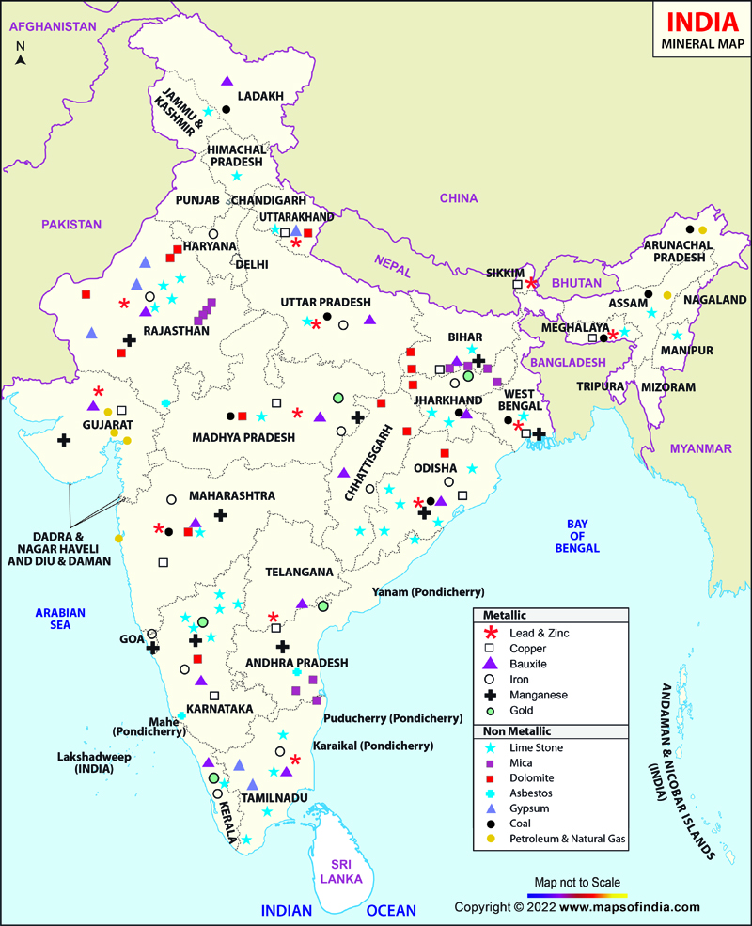
Background
Mining Industry: The India’s major mining regions are Jharkhand, Odisha, Chhattisgarh, Madhya Pradesh and Karnataka[1].
Common Risks[2]:
Gas leaks
Explosions
Roof collapses
Equipment Failures
India’s mining sector[1]:
Non Metallic mines (53 operational)
Depth: Typically from 200 m to 600 m.
Length: Typcally 2km to 4km.
Metallic mines (182 operational)
Depth: Typically from 1km to 4km.
Length: Typcally 2km to 5km.
Data Source: DGMS [1]

Slide 4
Mining Fatalities Statistics
Data Source: DGMS [1]
Data Source: DGMS [1]
Over the 15 year period (2010 to 2025), total mine accidents reported is around 20,025 which leads to total deaths of 49,615[1].
Globally, the annual number of fatal mining accidents is estimated to be in range of 300 to 400[1].

Slide 5
Causes of Mining Fatalities
Gas Accumulation (Methane, Carbon Monoxide, Hydrogen Sulfide): If sensors die due to low energy, gas levels go undetected, leads to explosions or suffocation which can be fatal[3].
Rock Falls/Roof Collapse:Vibration and structural stability sensors must operate continuously. If node energy depletes, blind spots occur and critical incidents happens[3][4].
High Temperature and Humidity Build-Up: Extreme underground heat can cause heat stroke, equipment malfunction and fire[4].
Communication Failures During Emergencies: Breakdown in communication prevents alerts from reaching control rooms. Most communication failures occur due to energy depleted sensor nodes or unstable routing[4].
In underground mines, sensing systems often fail early when WSN nodes rapidly run out of energy. By improving energy efficiency, these networks can provide continuous monitoring and timely alerts, which reduces the risk of fatalities.

Slide 6
Literature Review
Sl | Paper & Year | Optimization Technique Used | N/w Lifetime Improved | Limitations / Research gap
1 | Zhang et al. (2021) Energy-Efficient Clustering Routing Protocol Based on Weight for WSN in Coal Mine[5] | Weighted Clustering (Residual energy and Distance factors) | Improved by balancing energy in cluster heads | Does not adapt for dynamic topological
2 | Li et al. (2021) WSN Coverage Optimization in Coal Mine Based on Improved Whale Optimization Algorithm[6] | Whale Optimization Algorithm (WOA) | Extended by minimizing redundant coverage | High computational complexity for low-power sensor nodes
3 | Wang & Liu (2021) A Hybrid Energy-Efficient Routing Protocol for Underground Coal Mine Monitoring[7] | Hybrid Routing (Combining Tree-based and Cluster-based) | Prolonged network life in large scale linear topologies | Complexity in switching between modes leads to latency
4 | Chen et al. (2022) Research on Energy Balanced Routing Strategy for Coal Mine WSN based on Mobile Sink[8] | Mobile Sink (Sink moves to collect data) | Improves lifetime by 20% vs LEACH. | Requires precise path planning for the mobile vehicle.
5 | Kumar & Pal (2022) Fuzzy Logic Based Clustering Algorithm for WSN in Underground Mines[9] | Fuzzy Logic Controller | Better decision making for CH selection | Rule-base design is complex and static.

Slide 7
Literature Review
Sl | Paper & Year | Optimization Technique Used | N/w Lifetime Improved | Limitations / Research gap
6 | Al-Kaseem et al. (2022) Optimized Energy-Efficient Path Planning with Multiple Mobile Sinks[10] | Ant Colony Optimization + Genetic Algorithm | 66% vs. standard LEACH | Heavy computation demand Static environment
7 | Raed et al. (2022) Efficient Energy Mechanism for Underground Mining Monitoring[11] | Enhanced LEACH + DEECP | 25% vs standard LEACH | No mobility support Static environment
8 | Salman et al. (2022) Optimization of LEACH Protocol for WSNs in Terms of Energy Efficiency and Network Lifetime[12] | Particle Swarm Optimization | 30% vs. standard LEACH | No mobility support Non heterogeneous environmnt
9 | Gamal et al. (2022) Enhancing Lifetime of WSNs Using Fuzzy Logic LEACH and Particle Swarm Optimization[13] | Fuzzy + Particle Swarm Optimization | 18% vs. standard LEACH | Increased control overhead from fuzzy inference
10 | Mohapatra et al. (2022) Mobility Induced Multi-Hop LEACH Protocol in Heterogeneous Mobile Network[14] | Modified multi-hop LEACH | 20% vs. standard LEACH | Assumes uniform mobility Non heterogeneous environmnt

Slide 8
Literature Review
Sl | Paper & Year | Optimization Technique Used | N/w Lifetime Improved | Limitations / Research gap
11 | Botao Zhu et al. (2022) UAV Trajectory Planning in Wireless SensorNetworks by Deep Reinforcement Learning[15] | Used Deep Q-Network using neural network | Better Routing | Centralize control Computation heavy
12 | Liu et al. (2023) Improved Grey Wolf Optimizer (GWO) for 3D Node Coverage in Mines[16] | Grey Wolf Optimizer (GWO) | Maximizes coverage in 3D laneways | Does not fully account for signal multipath fading in tunnels.
13 | Adnan et al. (2023) LoRa-based Wireless Underground Sensor Networks: Evaluation and Deployment[17] | LoRa (Long Range) Modulation (Physical layer optimization) | Extend battery life due to low power usage. | Low data rate High Packet collision probability.
14 | Wu et al. (2023) Fault Tolerant Routing Mechanism for Underground Coal Mine WSN[18] | Multipath Routing (Redundant paths) | Increases reliability; | Higher energy cost due to redundant data transmission
15 | Yang et al. (2023) Dynamic Duty Cycling Scheme for Underground Mine Disaster Monitoring[19] | Dynamic Duty Cycling (Sleep/Wake scheduling) | Drastically reduces idle listening energy usage. | Increased delay in event detection and synchronization issues in deep tunnels.

Slide 9
Literature Review
Sl | Paper & Year | Optimization Technique Used | N/w Lifetime Improved | Limitations / Research gap
16 | Bibi et al. (2023) Energy Harvesting WSN Routing Protocol for Underground Applications[20] | Energy Harvesting Aware Routing | Extend lifetime if harvesting matches usage | Harvesting sources are intermittent requires battery
17 | Tadele A. Abose et al. (2023) Optimized Cluster Routing Protocol With Energy-Sustainable Mechanisms for Wireless Sensor Networks[21] | Stable Election Protocol | 36% vs standard LEACH | No Multi-hopping Homogenous network
18 | Saikat Chandra et al. (2024) LoRa-Based IIoT Network for Underground Coal Mine Environment[22] | Used LoRa to perform P2P communication | N/A | Clustering is missing
19 | Aleem & Thumma (2025) Hybrid DEEC EEKA RL in IoT- WSNs[23] | Residual energy ratio (DEEC) EEKA constraints + RL | 17.5% vs standard LEACH | Computational overhead, No mobility support
20 | Chaudhari, A., Deshpande (2025) Energy‑efficient Q‑learning-based routing in wireless sensor networks[24]. | Q-Learning + Optimized routing | 50% vs baseline Q-Learning | No multi-hop routing No comparison with classical protocols

Slide 10
Motivation & Problem Statement
Motivation:
Continuous sensing is critical in underground mines.
Sensor nodes die early due to limited battery.
Blind spots form, increasing accident risk.
Energy efficient nodes ensure reliable monitoring and worker safety.
Problem Statement:
Existing protocols such as LEACH and DEECP rely on static, heuristic-based cluster head selection and does not exploit node heterogeneity which leads to uneven energy consumption and premature node death. This reduces network lifetime compromises continuous monitoring in underground mines.
Objective:
Design an energy efficient architecture with intelligent decision making capabilities and dynamic adaptability for underground mine environments.
Achieve improvement in network lifetime by reducing premature node deaths and energy imbalance throughout the network.

Slide 11
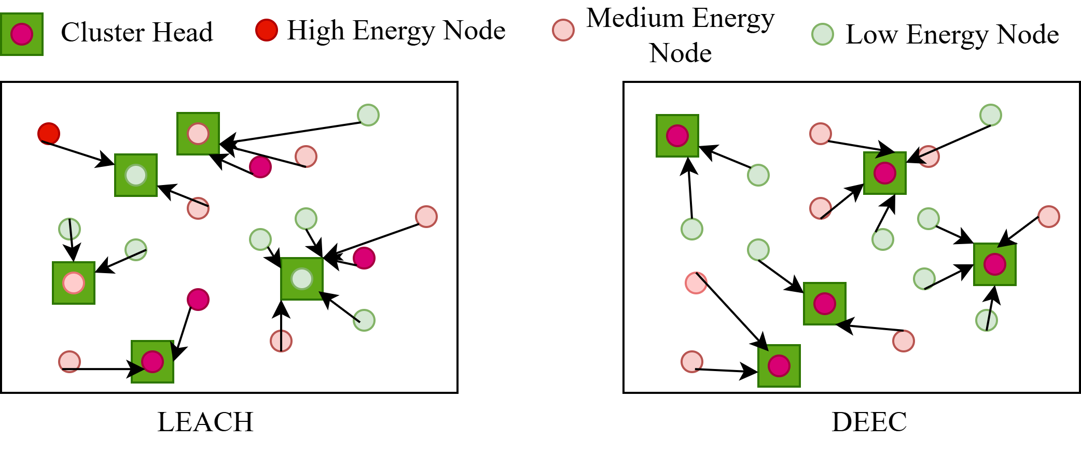
Overview of DEEC Protocol
DEEC(Distributed Energy-Efficient Clustering): It is a hierarchical routing protocol designed to maximize the lifetime of a WSN by balancing energy consumption among nodes[6].
The Core Problem It Solve: The "Energy Hole", in many protocols (like LEACH), CHs are chosen randomly and not chosen in recent past, which leads nodes with low energy to become CHs and they die quickly.
Energy Aware Clustering: DEECP incarporates CH selection is based on a node's remaining (residual) energy. Nodes with more energy have a higher probability of being selected as a CH.
Fig 2: LEACH vs DEEC

Slide 12
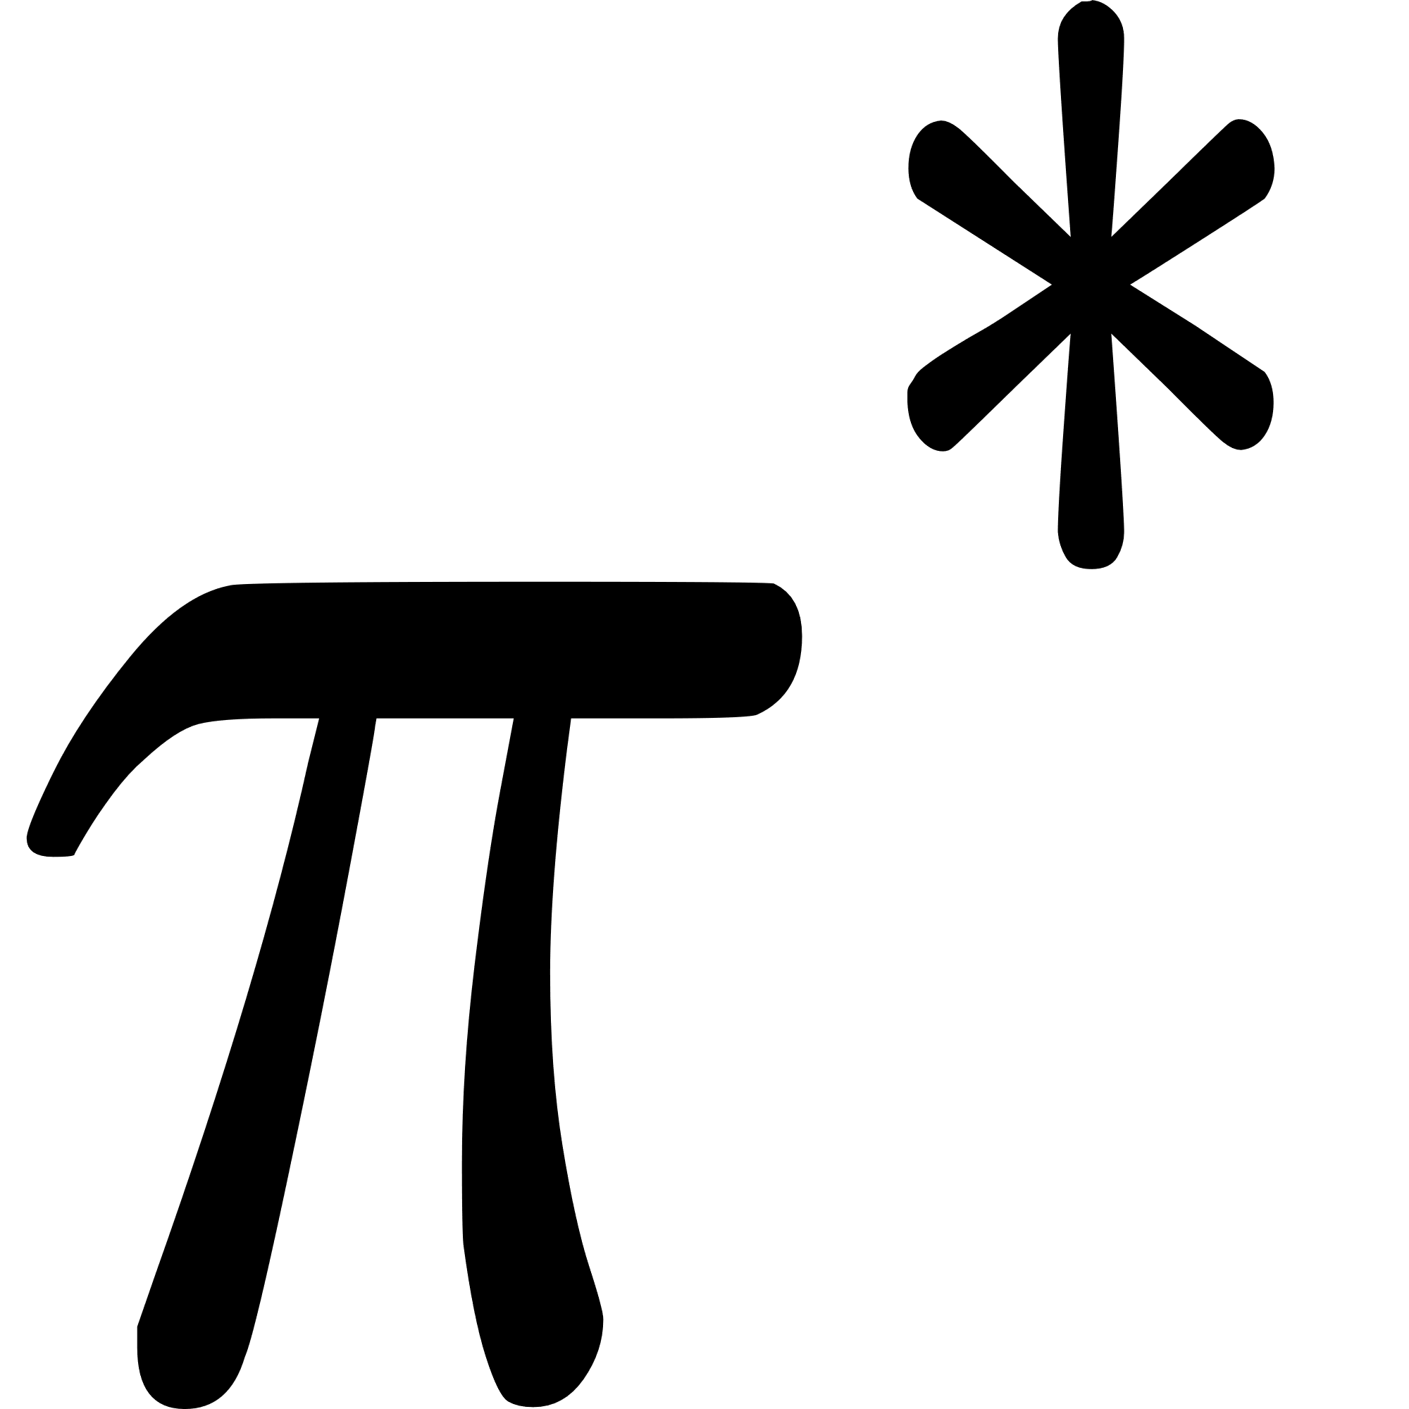
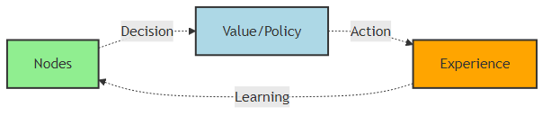
Overview of Reinforcement Learning
Definition: Reinforcement Learning (RL) is a learning paradigm where an agent learns to make decisions by interacting with an environment to maximize cumulative reward[13].
Agent Environment Interaction:
Agent: Makes decisions by taking actions
Environment: Responds with new states and rewards/penalty
Goal: Find an optimal policy that maximizes expected return
Trial-and-Error Learning: Agent explores actions, observes outcomes and updates its strategy iteratively.
Fig 1: Agent learning behavior

Slide 13


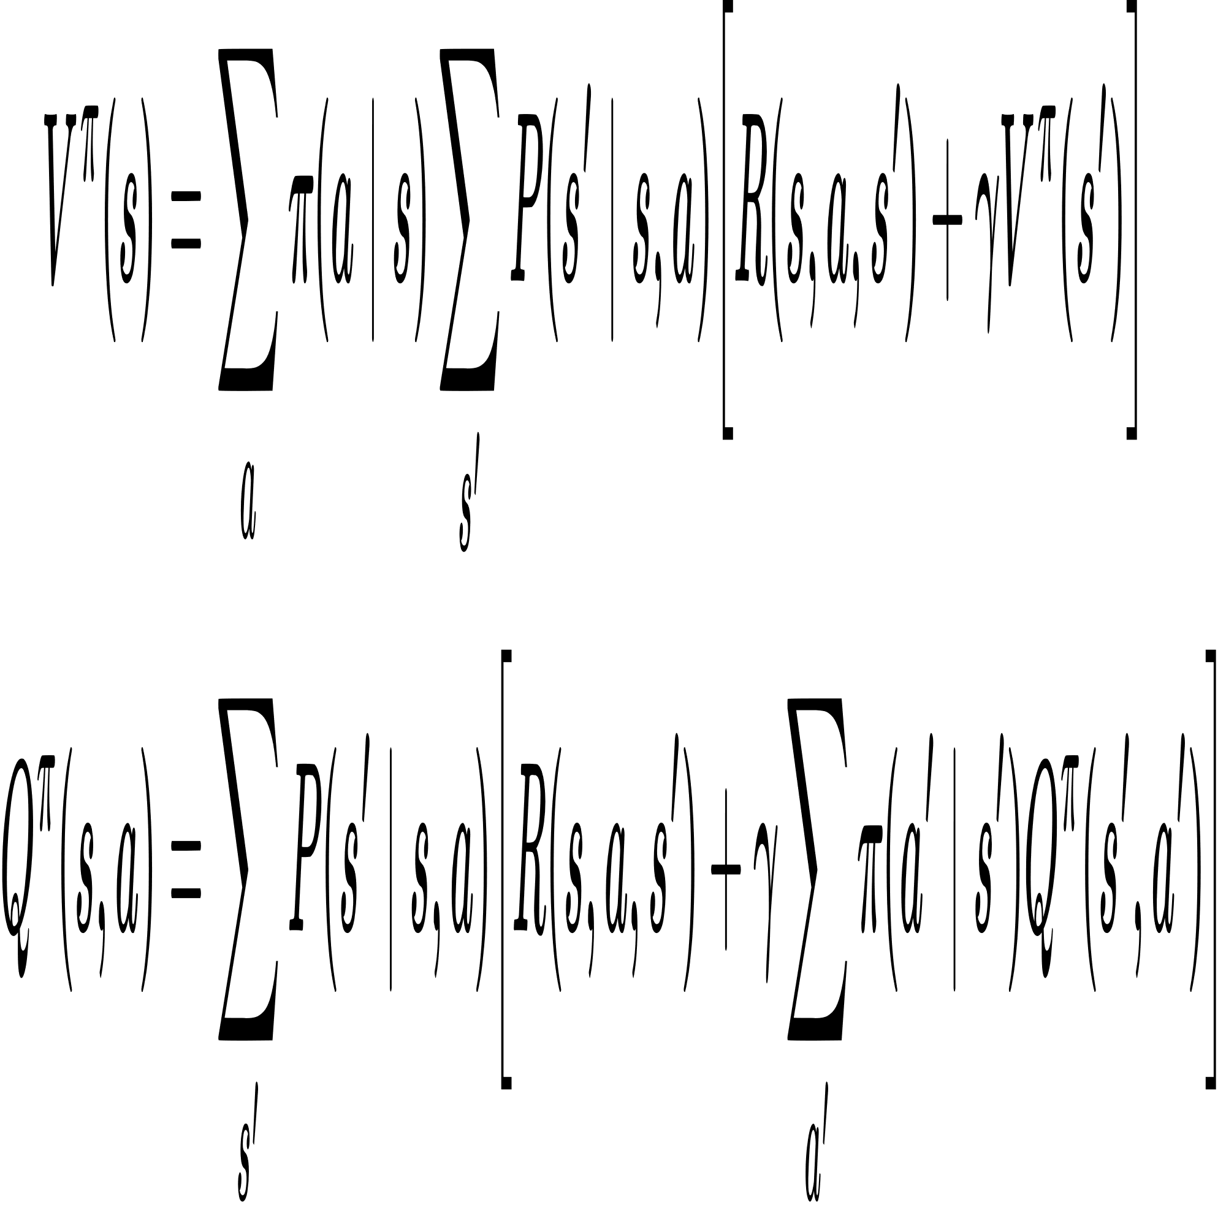
Value Functions and Bellman Equations
State Value Function : It maps expected return under policy 𝜋, using MDP transition probabilities and reward function[14].
Action-Value Function : It maps state-action pairs to expected return based on MDP dynamics. It allows RL to determine which action in a given state is best[14].
Bellman Equations: Encode recursive relationship between the current value of a state and values of successor states using MDP’s transition and reward functions[13],[14].
Use Case: Using these equations, we iteratively compute the optimal state value or optimal policy, as the Bellman equation is bound to converge.

Slide 14
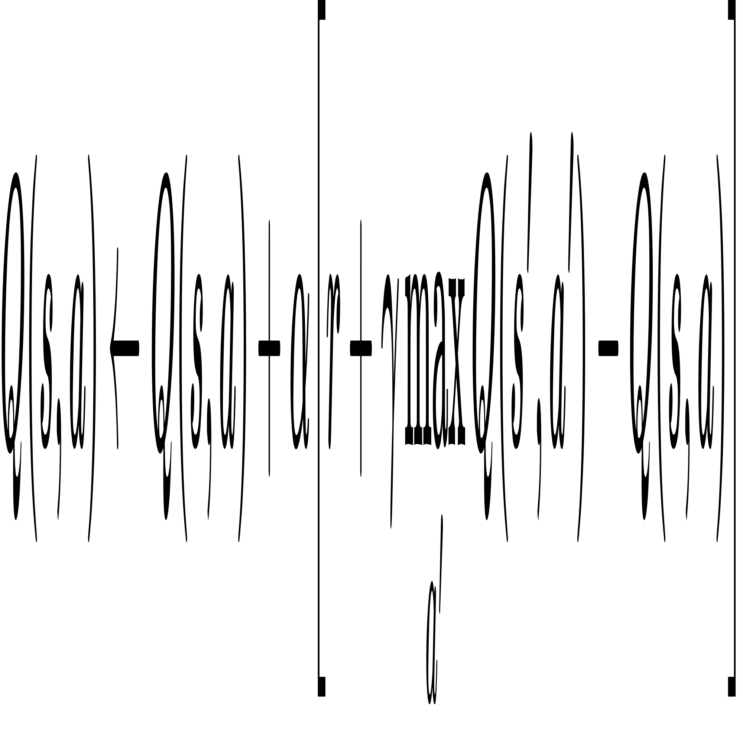
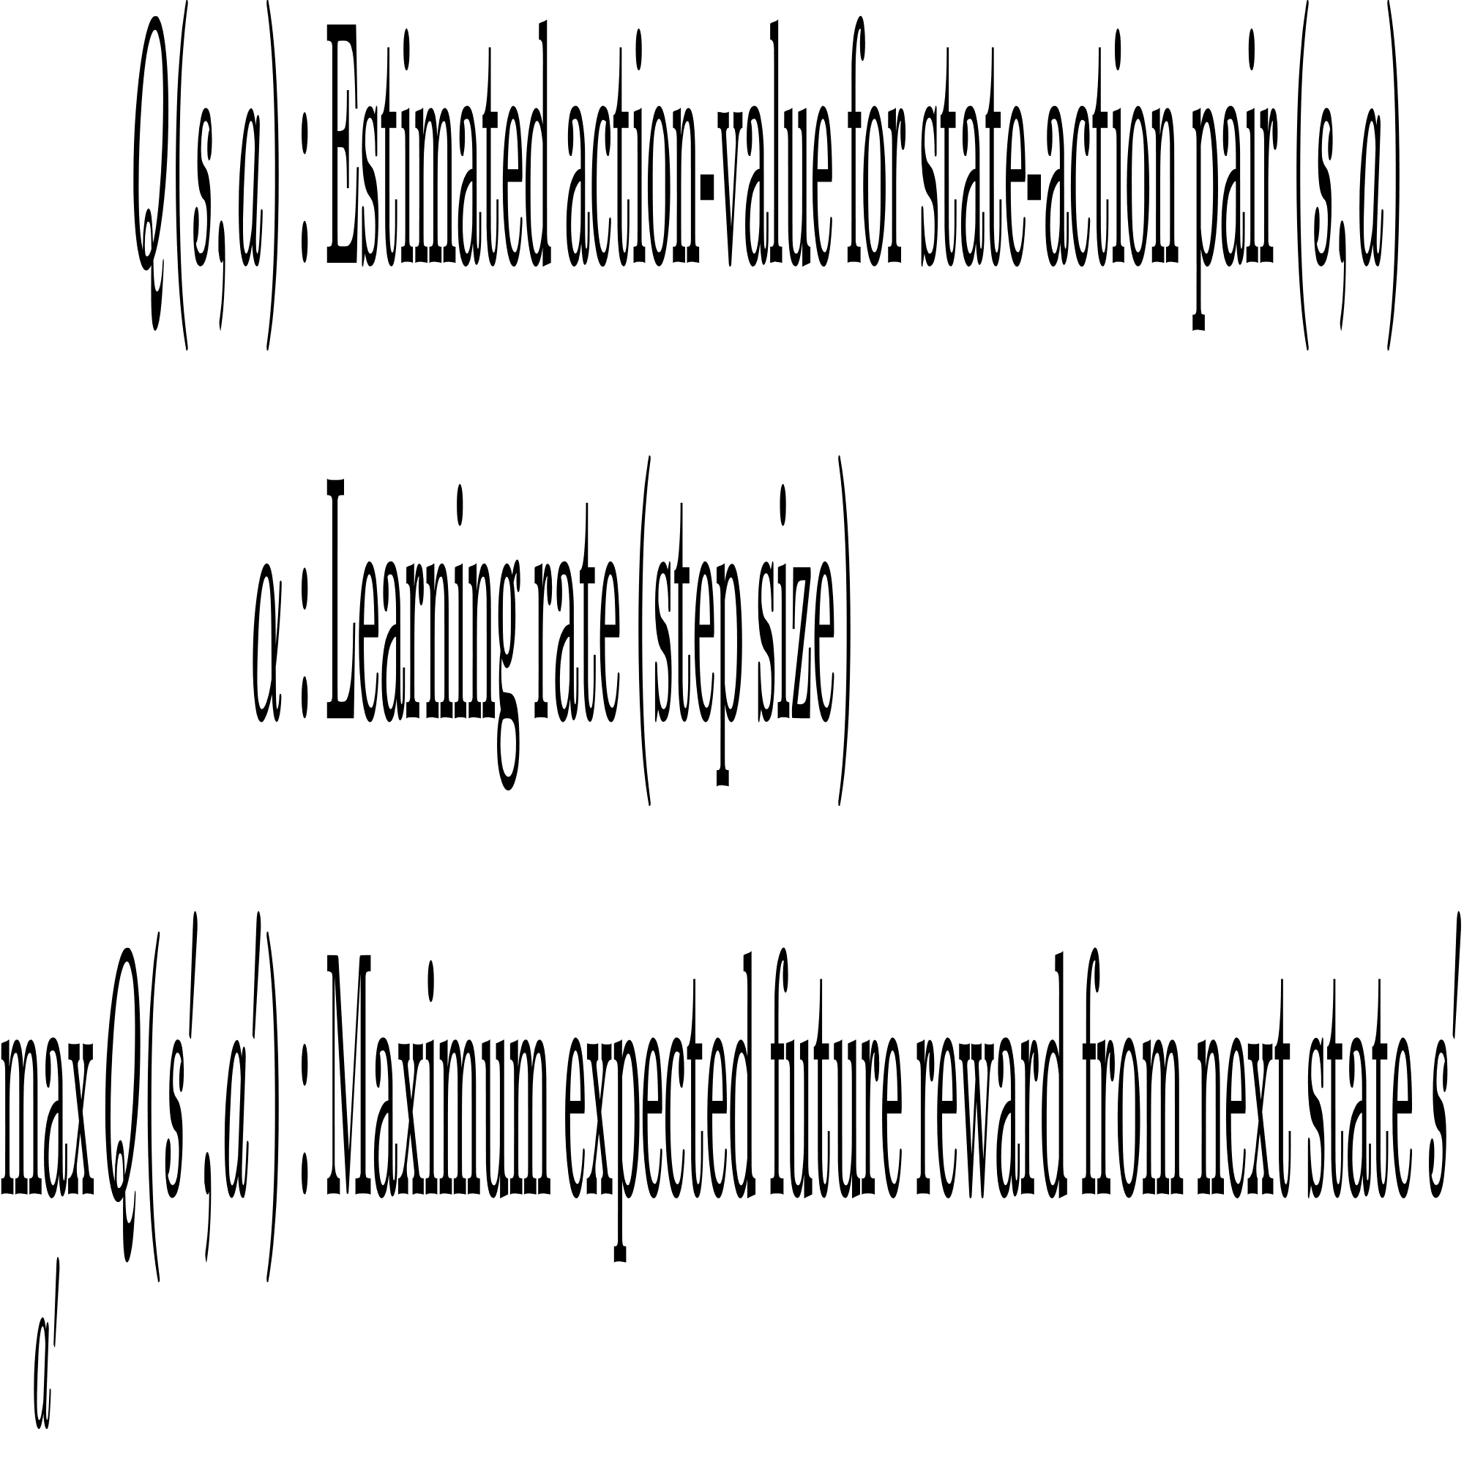
Model Free RL Q-Learning
Overview: Q-Learning enables the agent to learn the optimal action-value function that is 𝑄∗(s,a) through trial-and-error by maintaining a Q-table for all state action pairs.
Q-Learning Update Formula: This iterative formula solves the Bellman optimality equation for action values, allowing direct convergence to the optimal policy[14].
Q-Table: Stores Q(s,a) for all state-action pairs, where rows represent states and columns represent actions, holding expected rewards to guide the agent toward optimal actions[14].

Slide 15
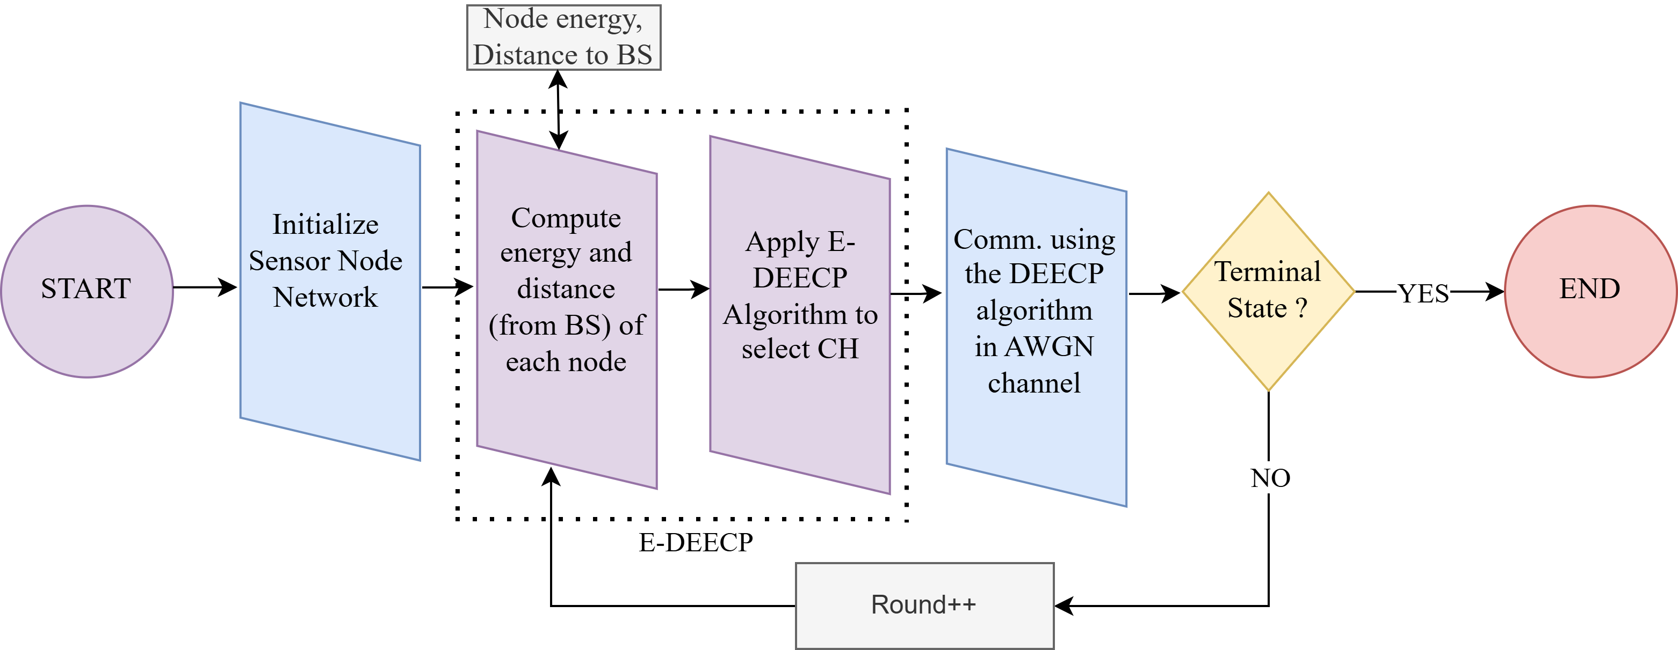
E-DEECP Block Diagram
Fig 3: Block digram of deecp and e-deecp method

Slide 16
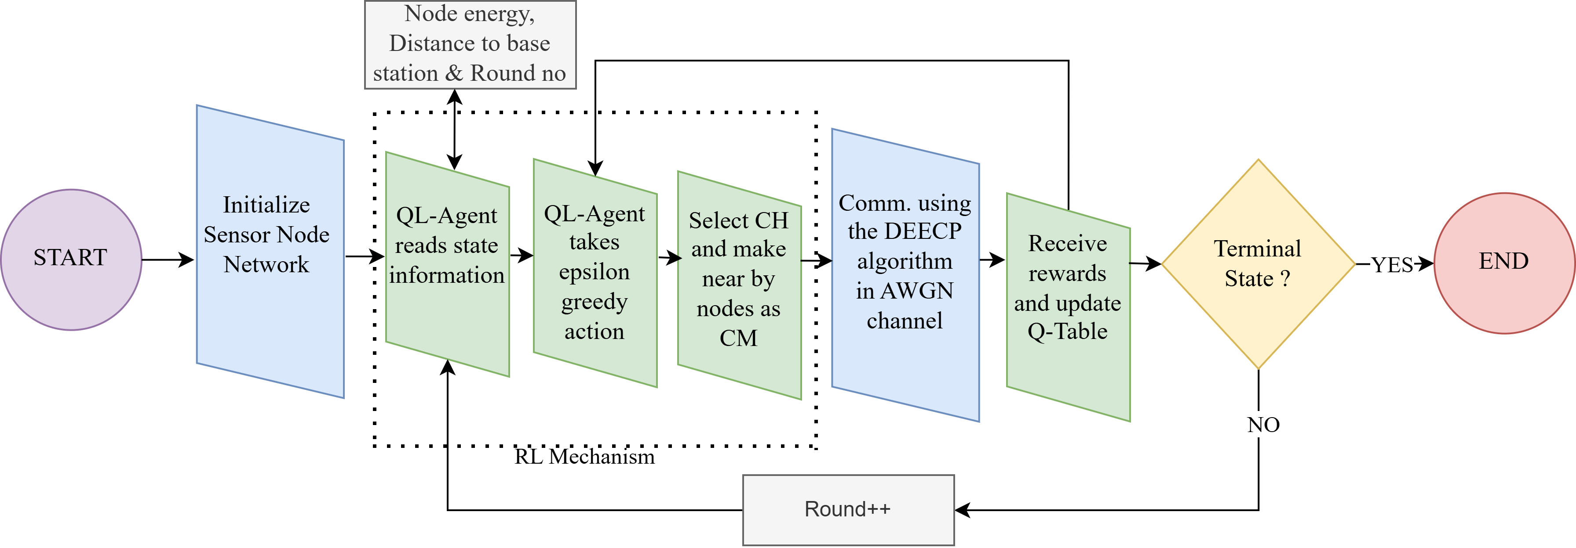
Q-Learning in WSN (POC)
Fig 4: Block digram of QL-DEECP method

Slide 17
Q-Learning in WSN (POC)
Agent reads node state: Remaining energy, Distance to BS and Round number.
Selects action using epsilon-greedy: Explore new CHs or exploit best known CH.
Chooses Cluster Head: Highest valued node becomes CH; others join as CMs.
Communication occurs: Nodes send data to CH, CH aggregates and sends to BS.
Reward is computed: Based on energy consumption, alive nodes, and balanced CH selection.
Q-table updated: Agent learns which node is best suited as CH in future rounds.
Check terminal state: If nodes die stop, else continue to next round.

Slide 18
Simulation Environment
Physical Layer Parameters | Value
Sink (BS) location | Center
Number of nodes | 50
Node mobility | Static
Channel model | AWGN
Sensing/traffic model | Periodic
Network Parameters | Value
WSN area size | 500m x 500m
Initial energy | 0.5 Joules
Packet size | 3000 bits
Data aggregation energy | 5n J/bit/signal
Transmit energy | 50n J/bit
Receive energy | 50n J/bit
Free space loss | 10n J/bit
Multipath loss | 0.0013p J/bit
Simulation Rounds | 10000
Application/Software | Version
Python | 3.11.1
Antigravity | A1

Slide 19
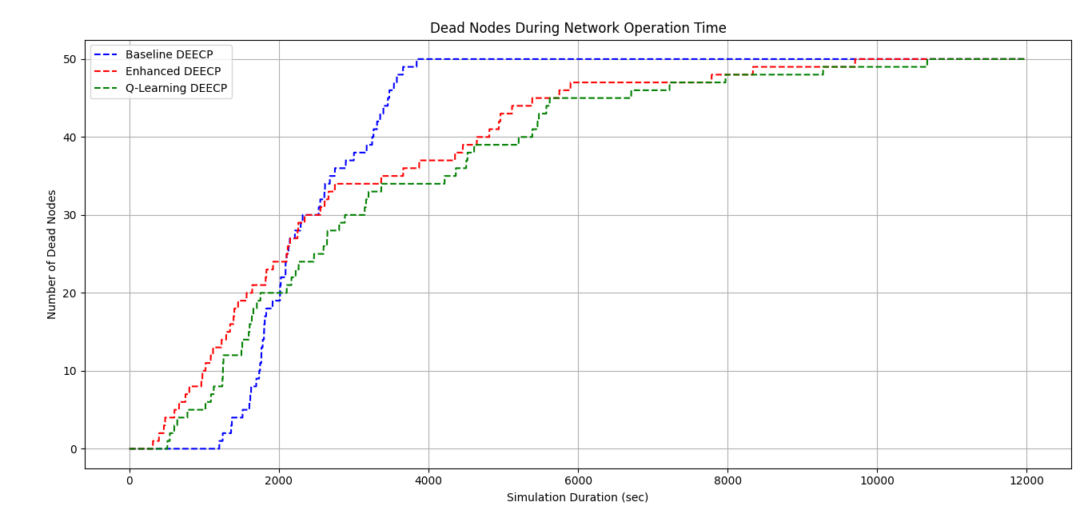
Simulation Results
~3842
~9705
~10700
Fig 5: Network Lifetime for 50 nodes

Slide 20
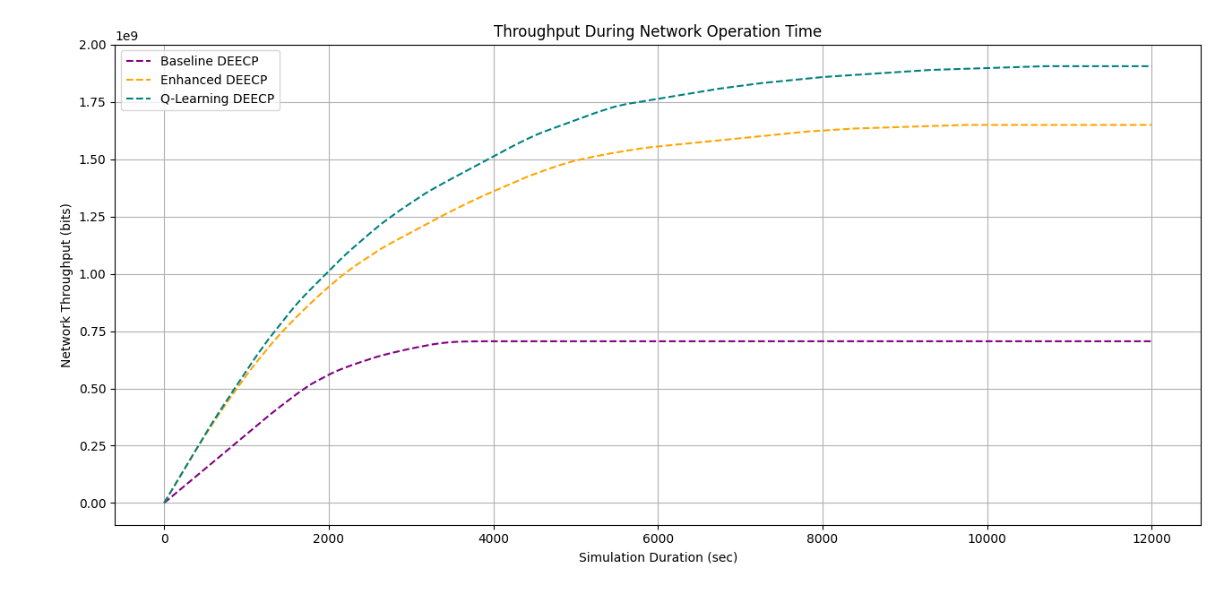
Simulation Results
~13%
~140%
Number of bits
Fig 6: Network Throughput for 50 nodes

Slide 21
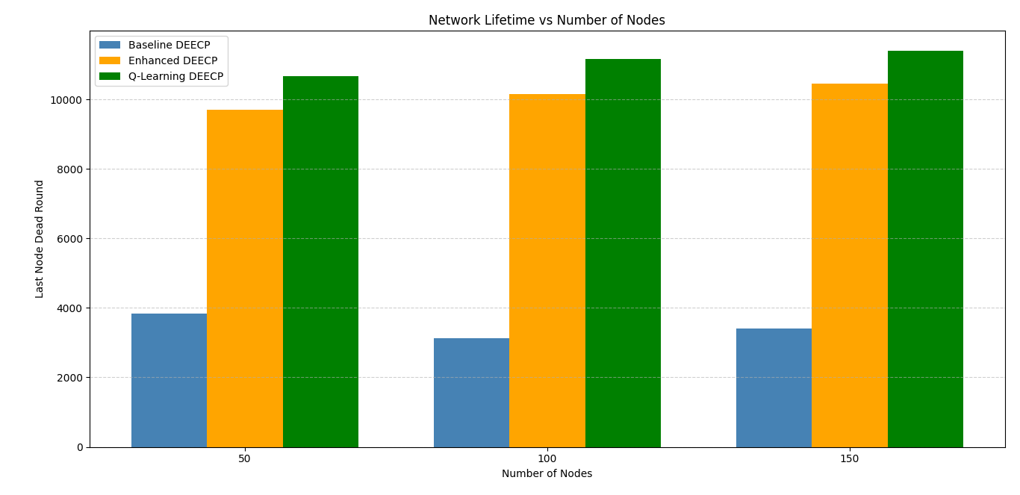
Simulation Results
~11%
~11%
~10%
~150%
~160%
~155%
Fig 7: Network Lifetime Comparision for 50 nodes

Slide 22
Result Summary
Table 1: Node death comparision table for 50 nodes
For Number of Nodes = 50
Milestone | Baseline DEECP (rounds) | Enhanced DEECP (rounds) | Q-Learning DEECP (rounds)
1st Node Death | 1203 | 315 | 508
50% Node Death | 2128 | 2117 | 2596
90% Node Death | 3476 | 5749 | 6711
Last Node Death | 3842 | 9705 | 10700
Throughput | 70kbit/sec | 160kbit/sec | 190kbits/sec
QL-DEECP vs Baseline DEECP
+160% Network Lifetime
+140% Throughput
QL-DEECP vs Enhanced DEECP (E-DEECP)
+10% Network Lifetime
+13% Throughput

Slide 23
Conclusion
QL-DEECP achieves the best performance, extending total network lifetime by up to +160% over Baseline and +10% over Enhanced DEECP.
Throughput improves significantly, reaching +140% over Baseline and +13% over Enhanced DEECP.
Q-learning enables adaptive, energy-aware CH selection, reducing premature node deaths and balancing load across the network.
Overall, QL-DEECP provides the most stable, energy-efficient, and high-throughput operation for homogeneous WSNs.

Slide 24
Future Work Motivation
Limitations of QL-DEECP
No spatial cluster optimization
Lacks multi-hop routing
Limited state representation (It does not capture complex features such as node density, cluster load, PDR)
Does NOT support node/BS mobility
No hybrid modeling of channel

Slide 25
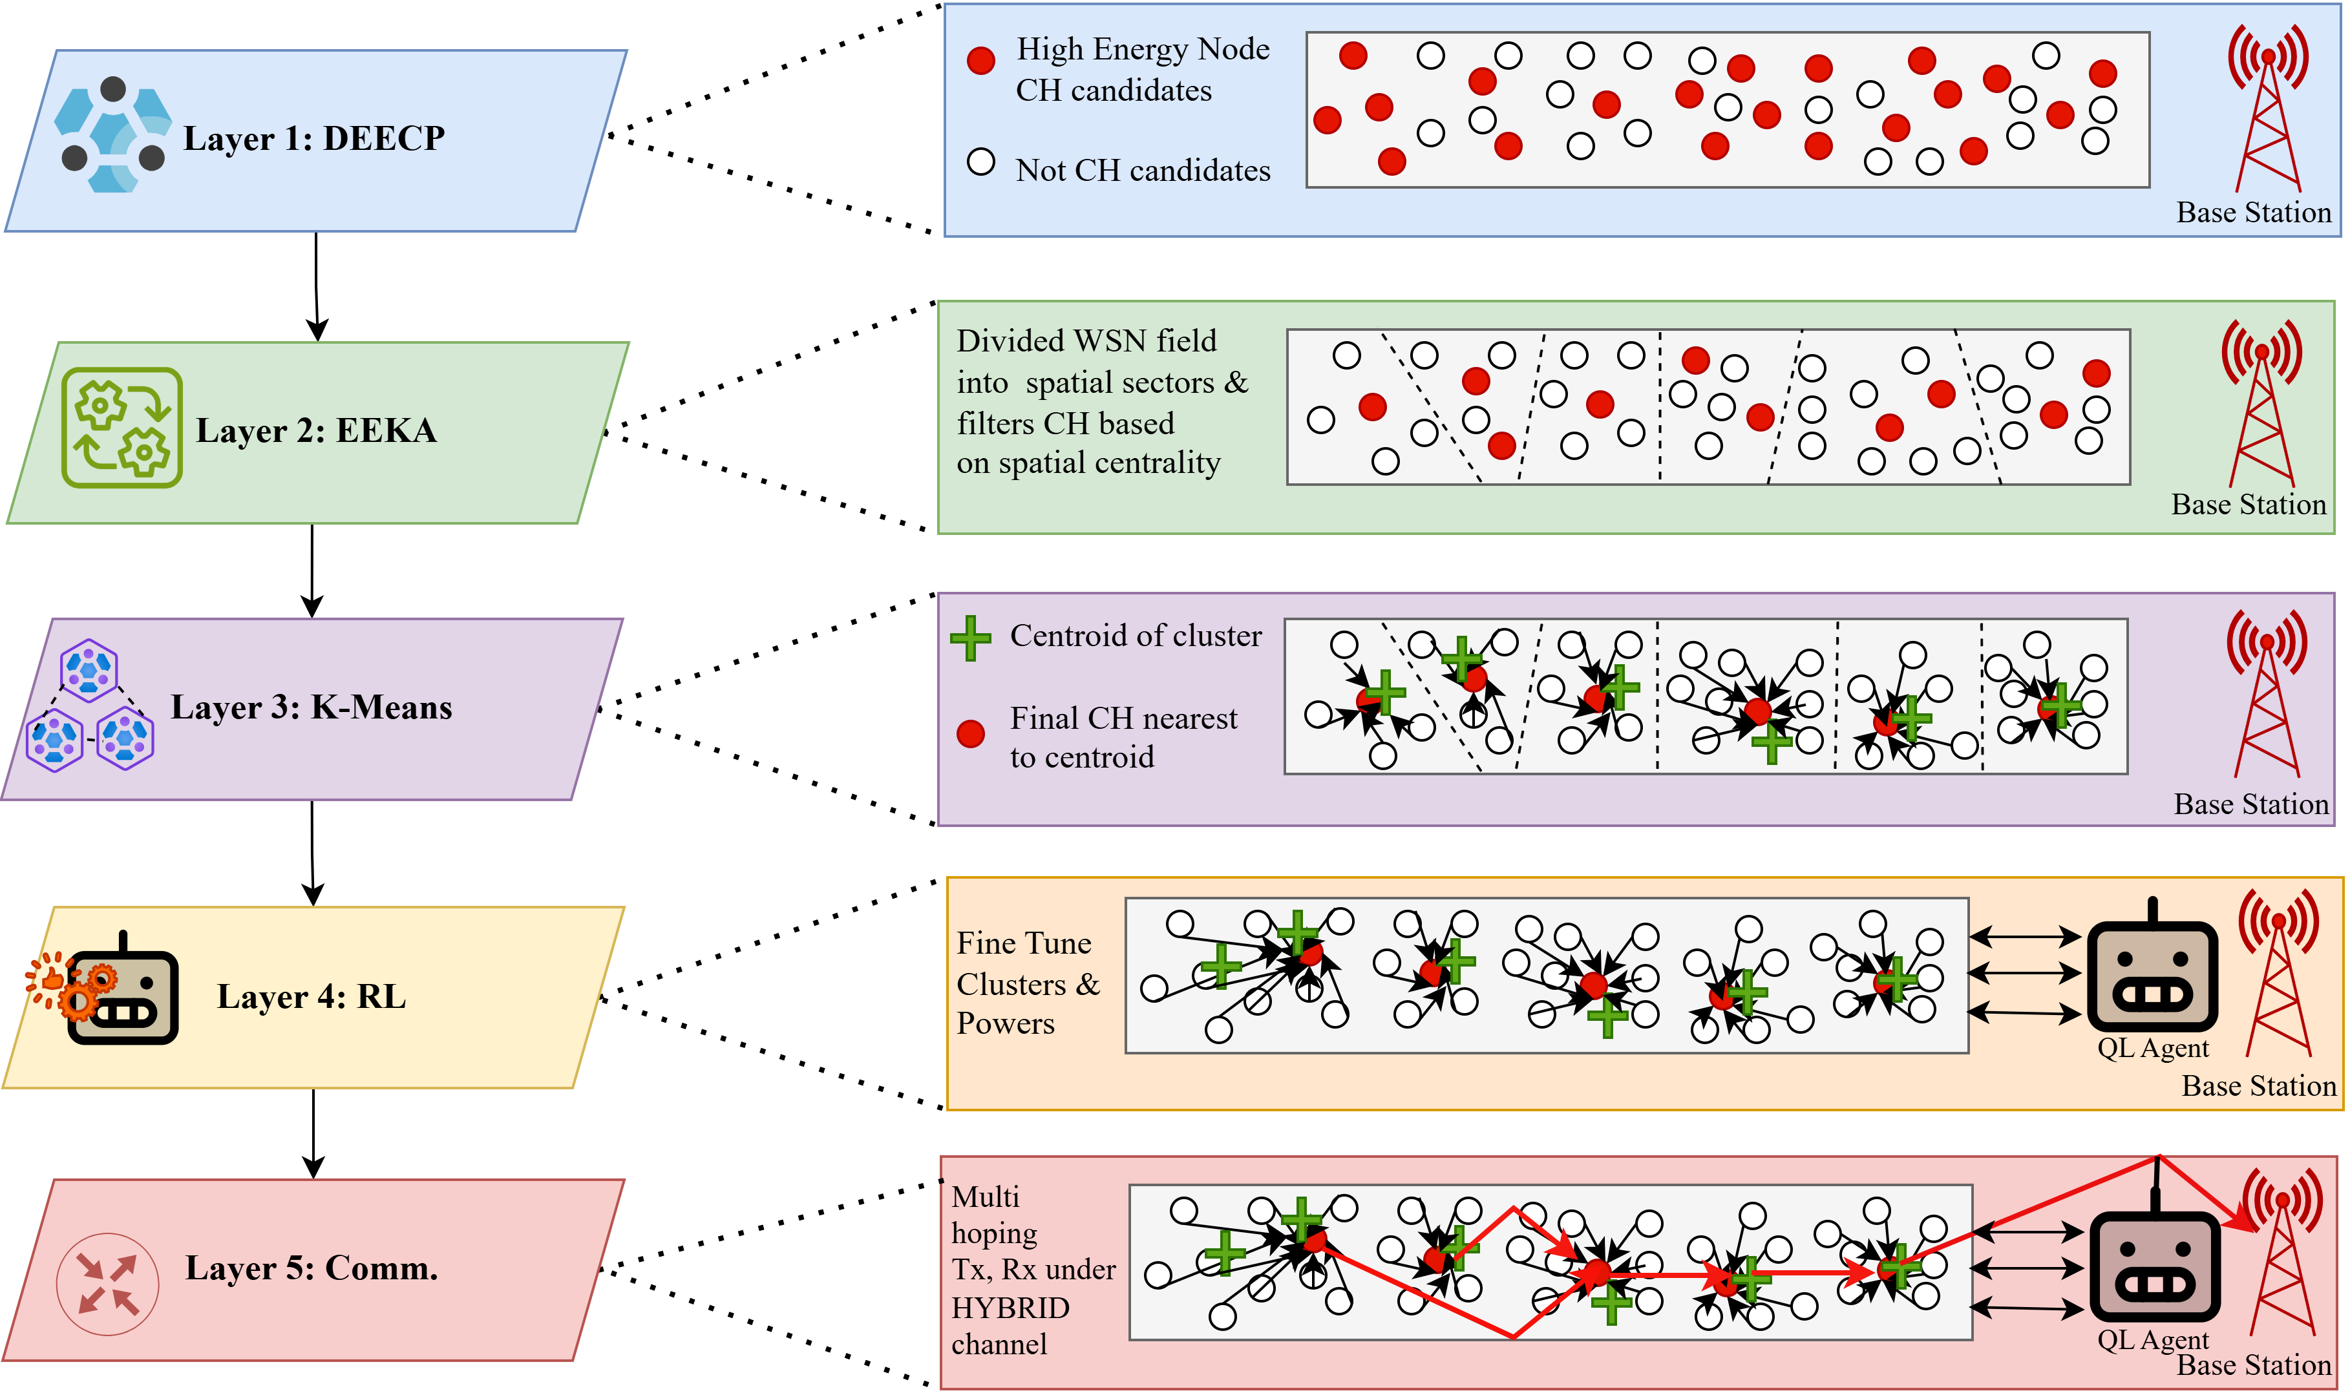
Future Work
Fig 8: Reinforcement Learning driven Hybrid Clustering (RLHC)

Slide 26
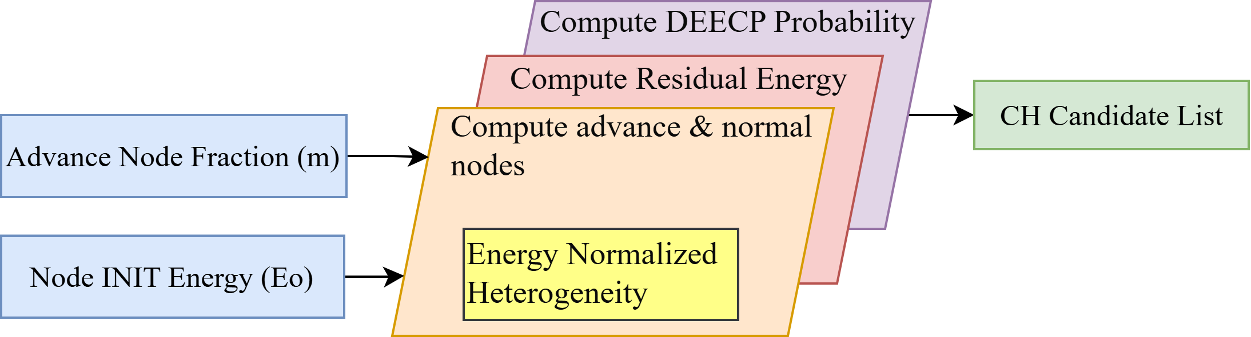
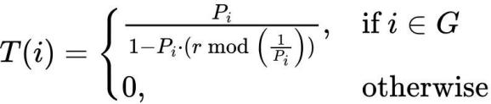
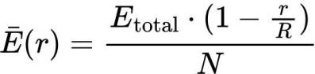
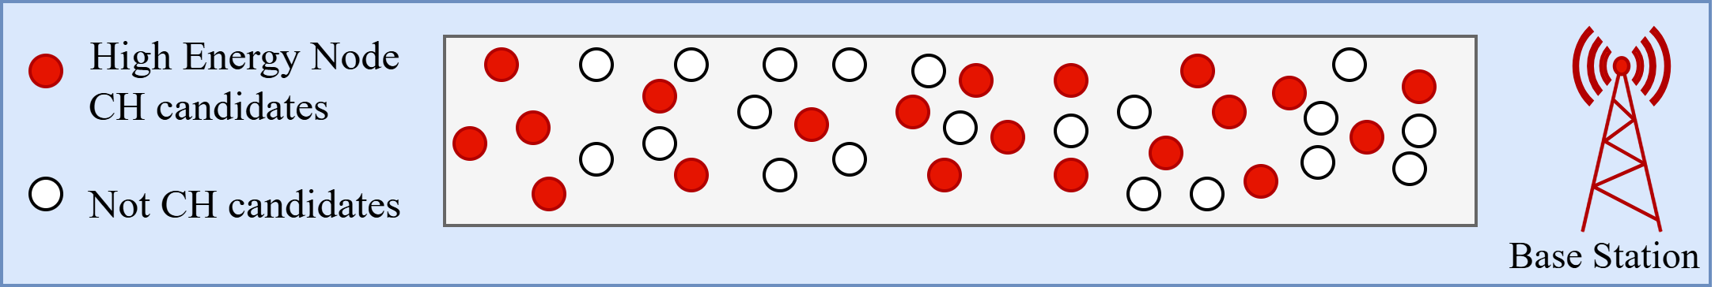
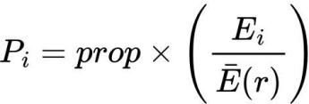
Layer 1: Distributed Energy Efficient Clustering Protocol
Incorporates node heterogeneity.
Provides an energy aware CH list.
The core equations that guide DEECP are:
Fig 9: DEEC Protocol
Fig 10: Candidates cluster heads

Slide 27
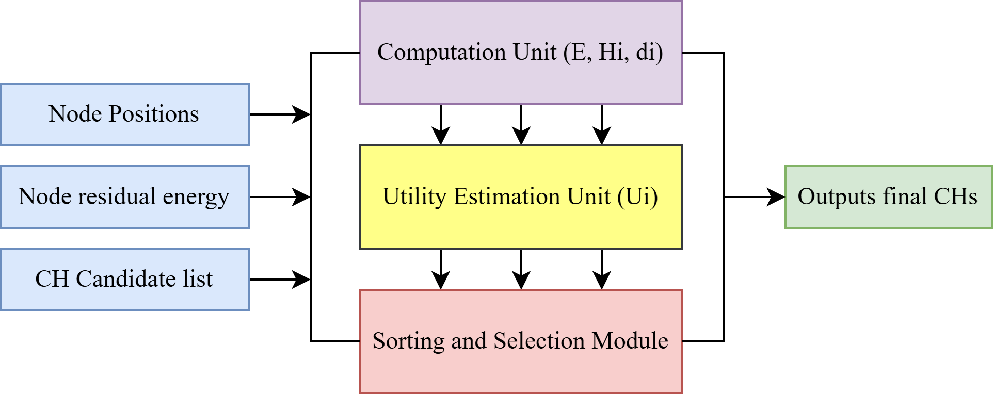
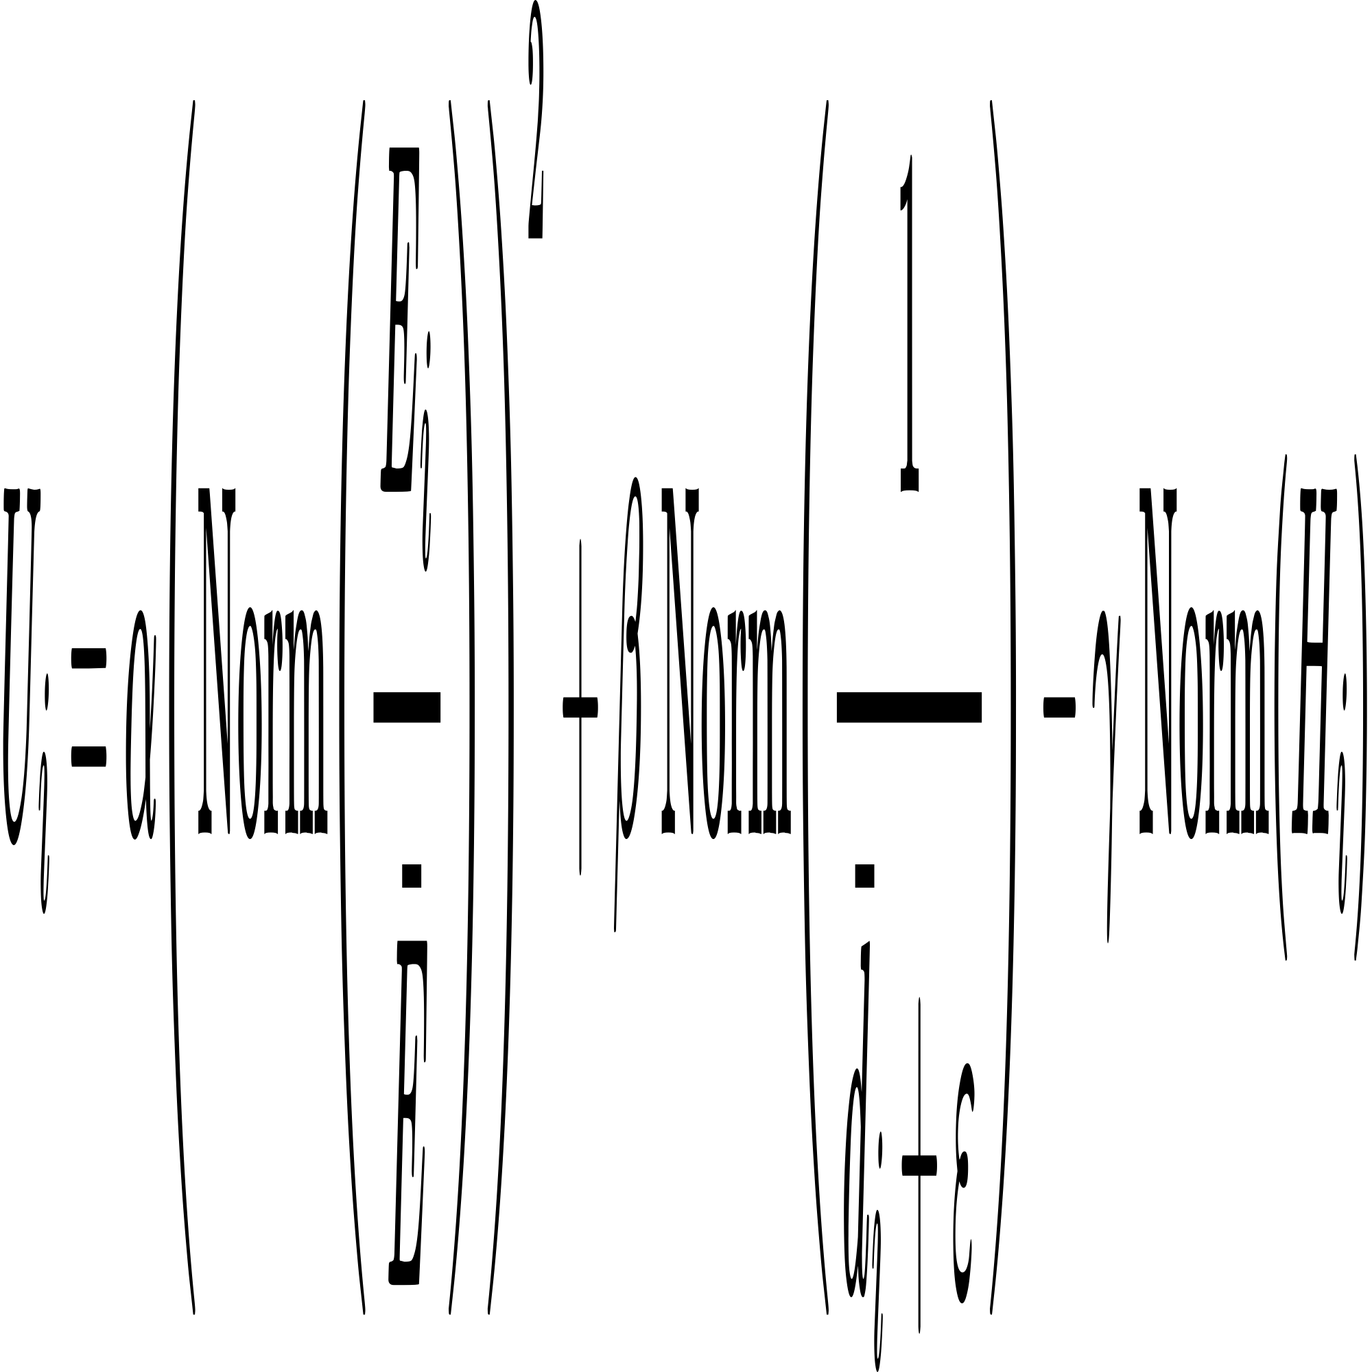
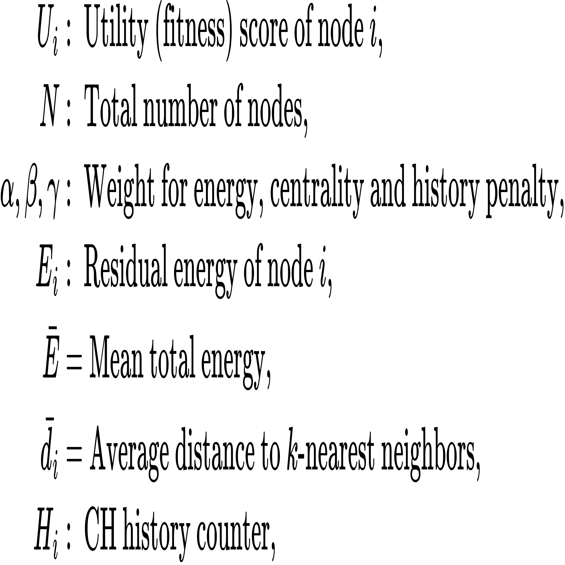
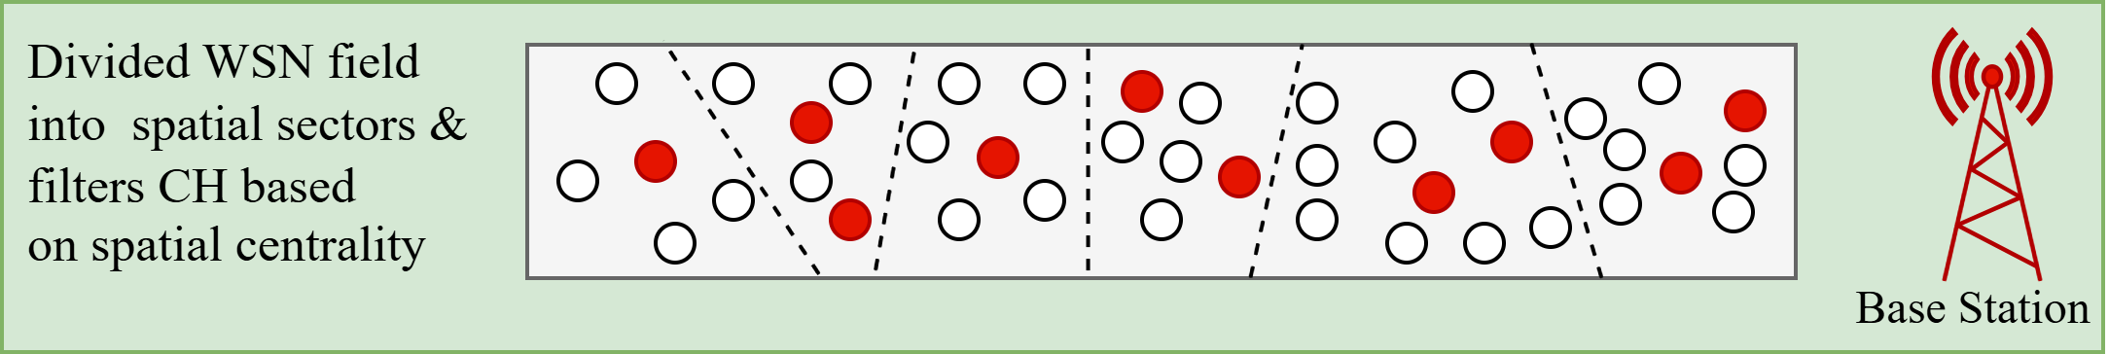
Layer 2: Energy Efficient Knapsack Algorithm
Ensures CH centrality (better positioning)
Maintains spatial diversity among CHs
The core equation that guide EEKA is:
Fig 11: EEK Algorithm
Fig 12: Spatially and centrally distributed CH

Slide 28
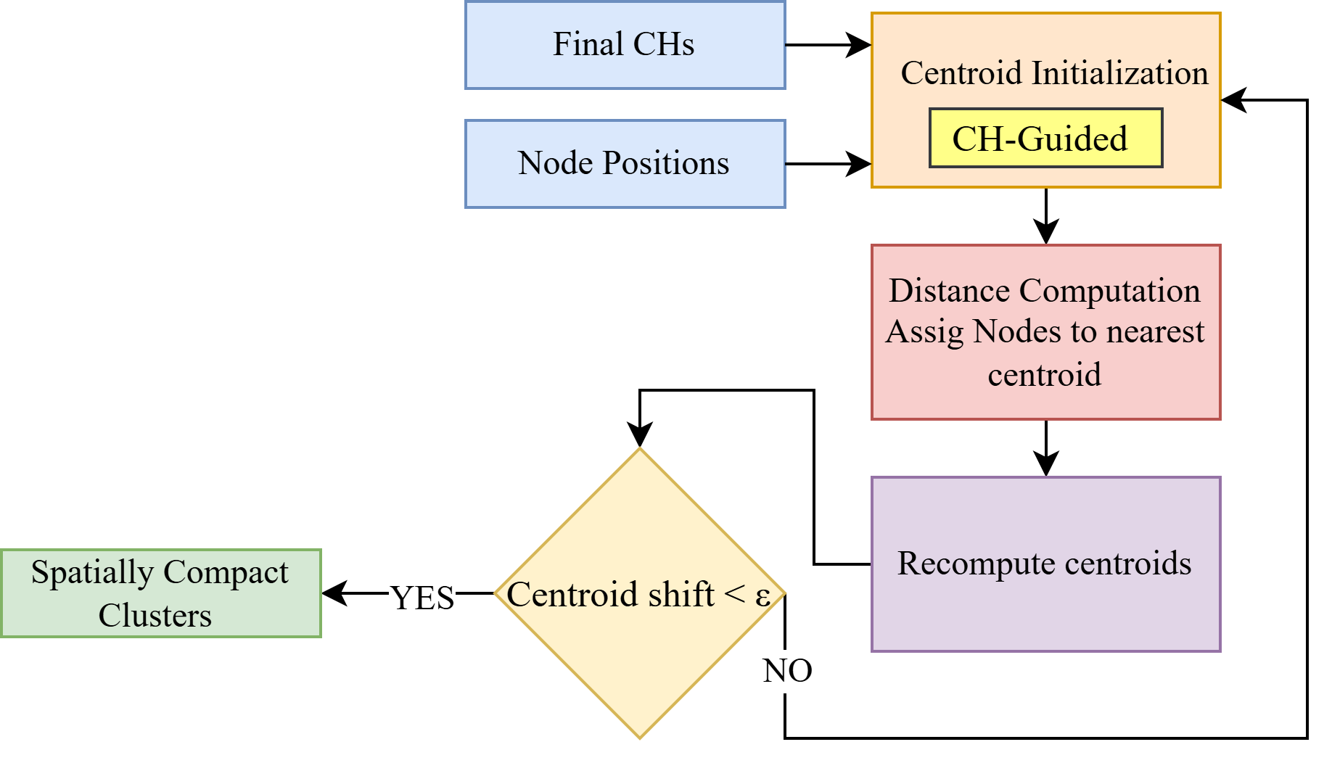
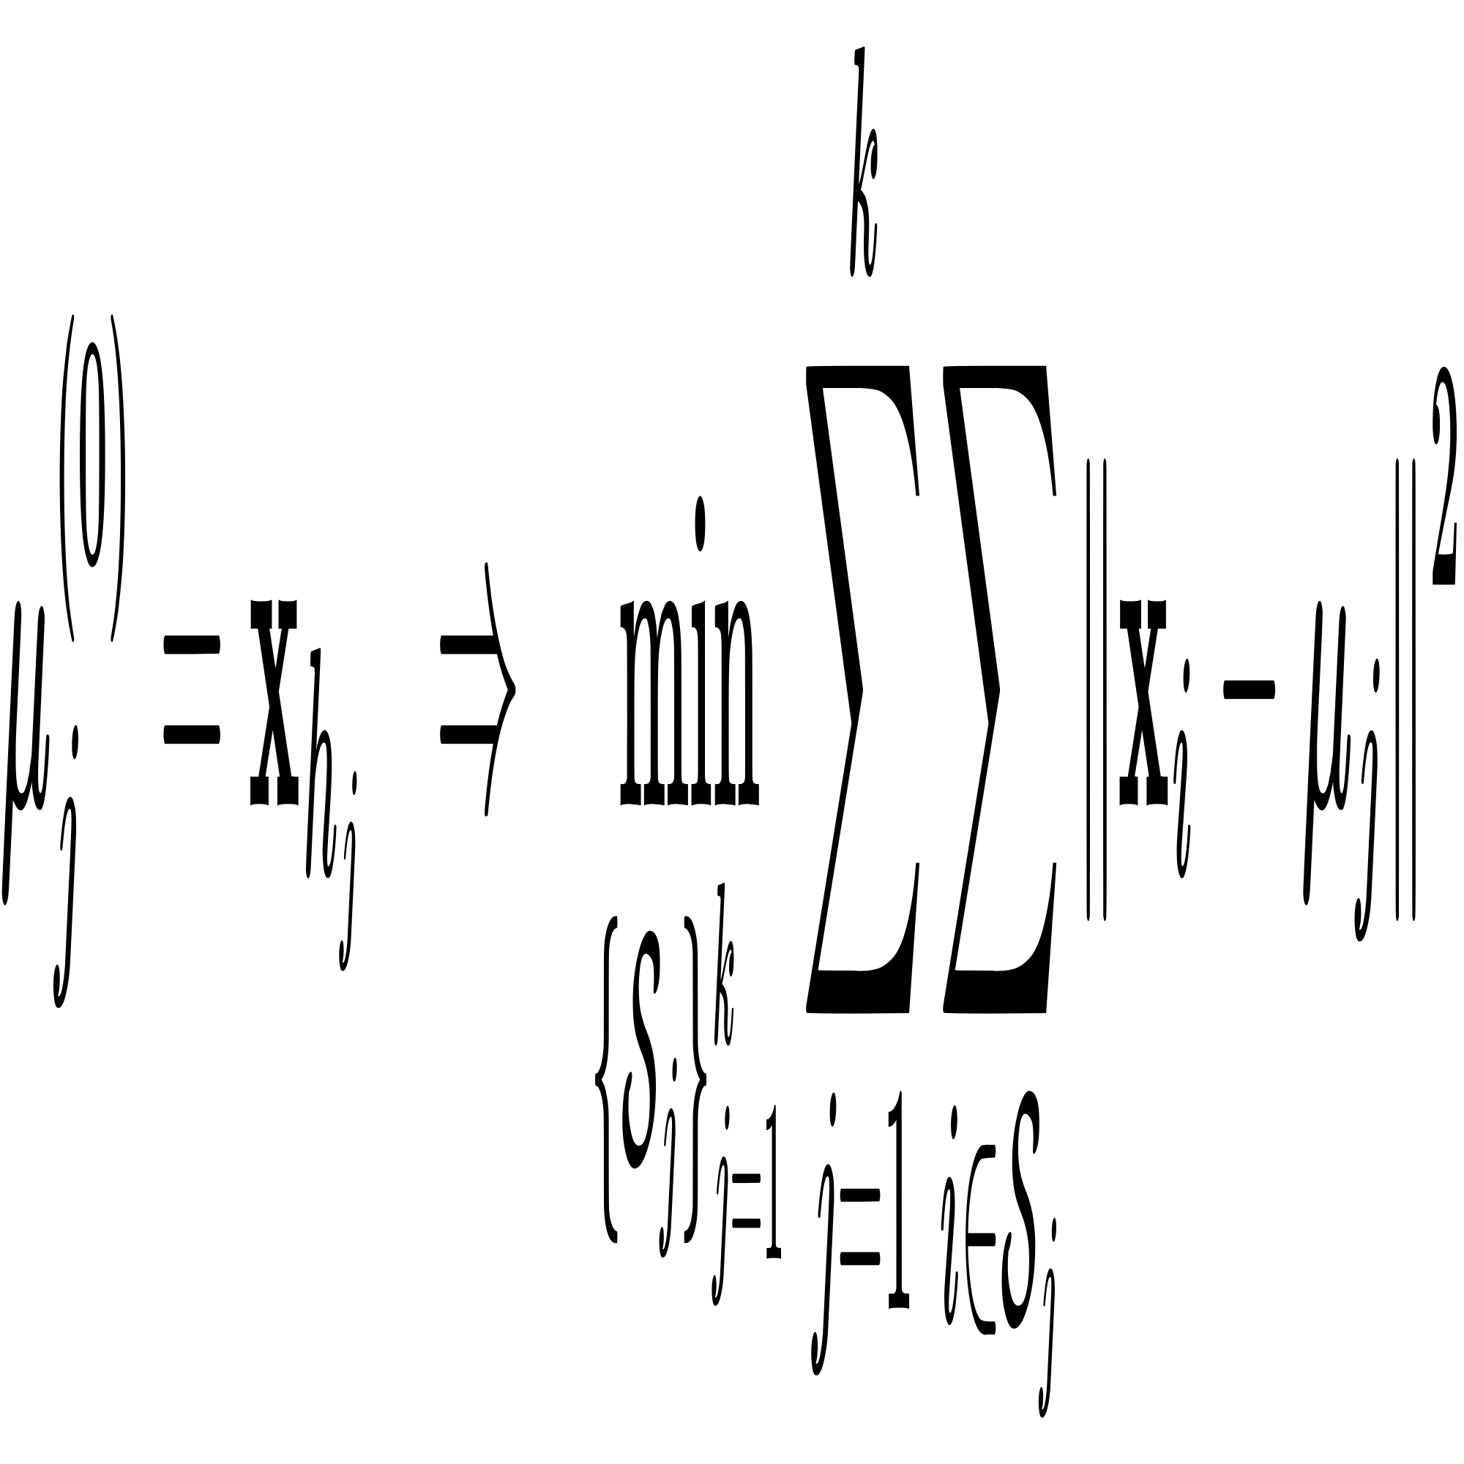
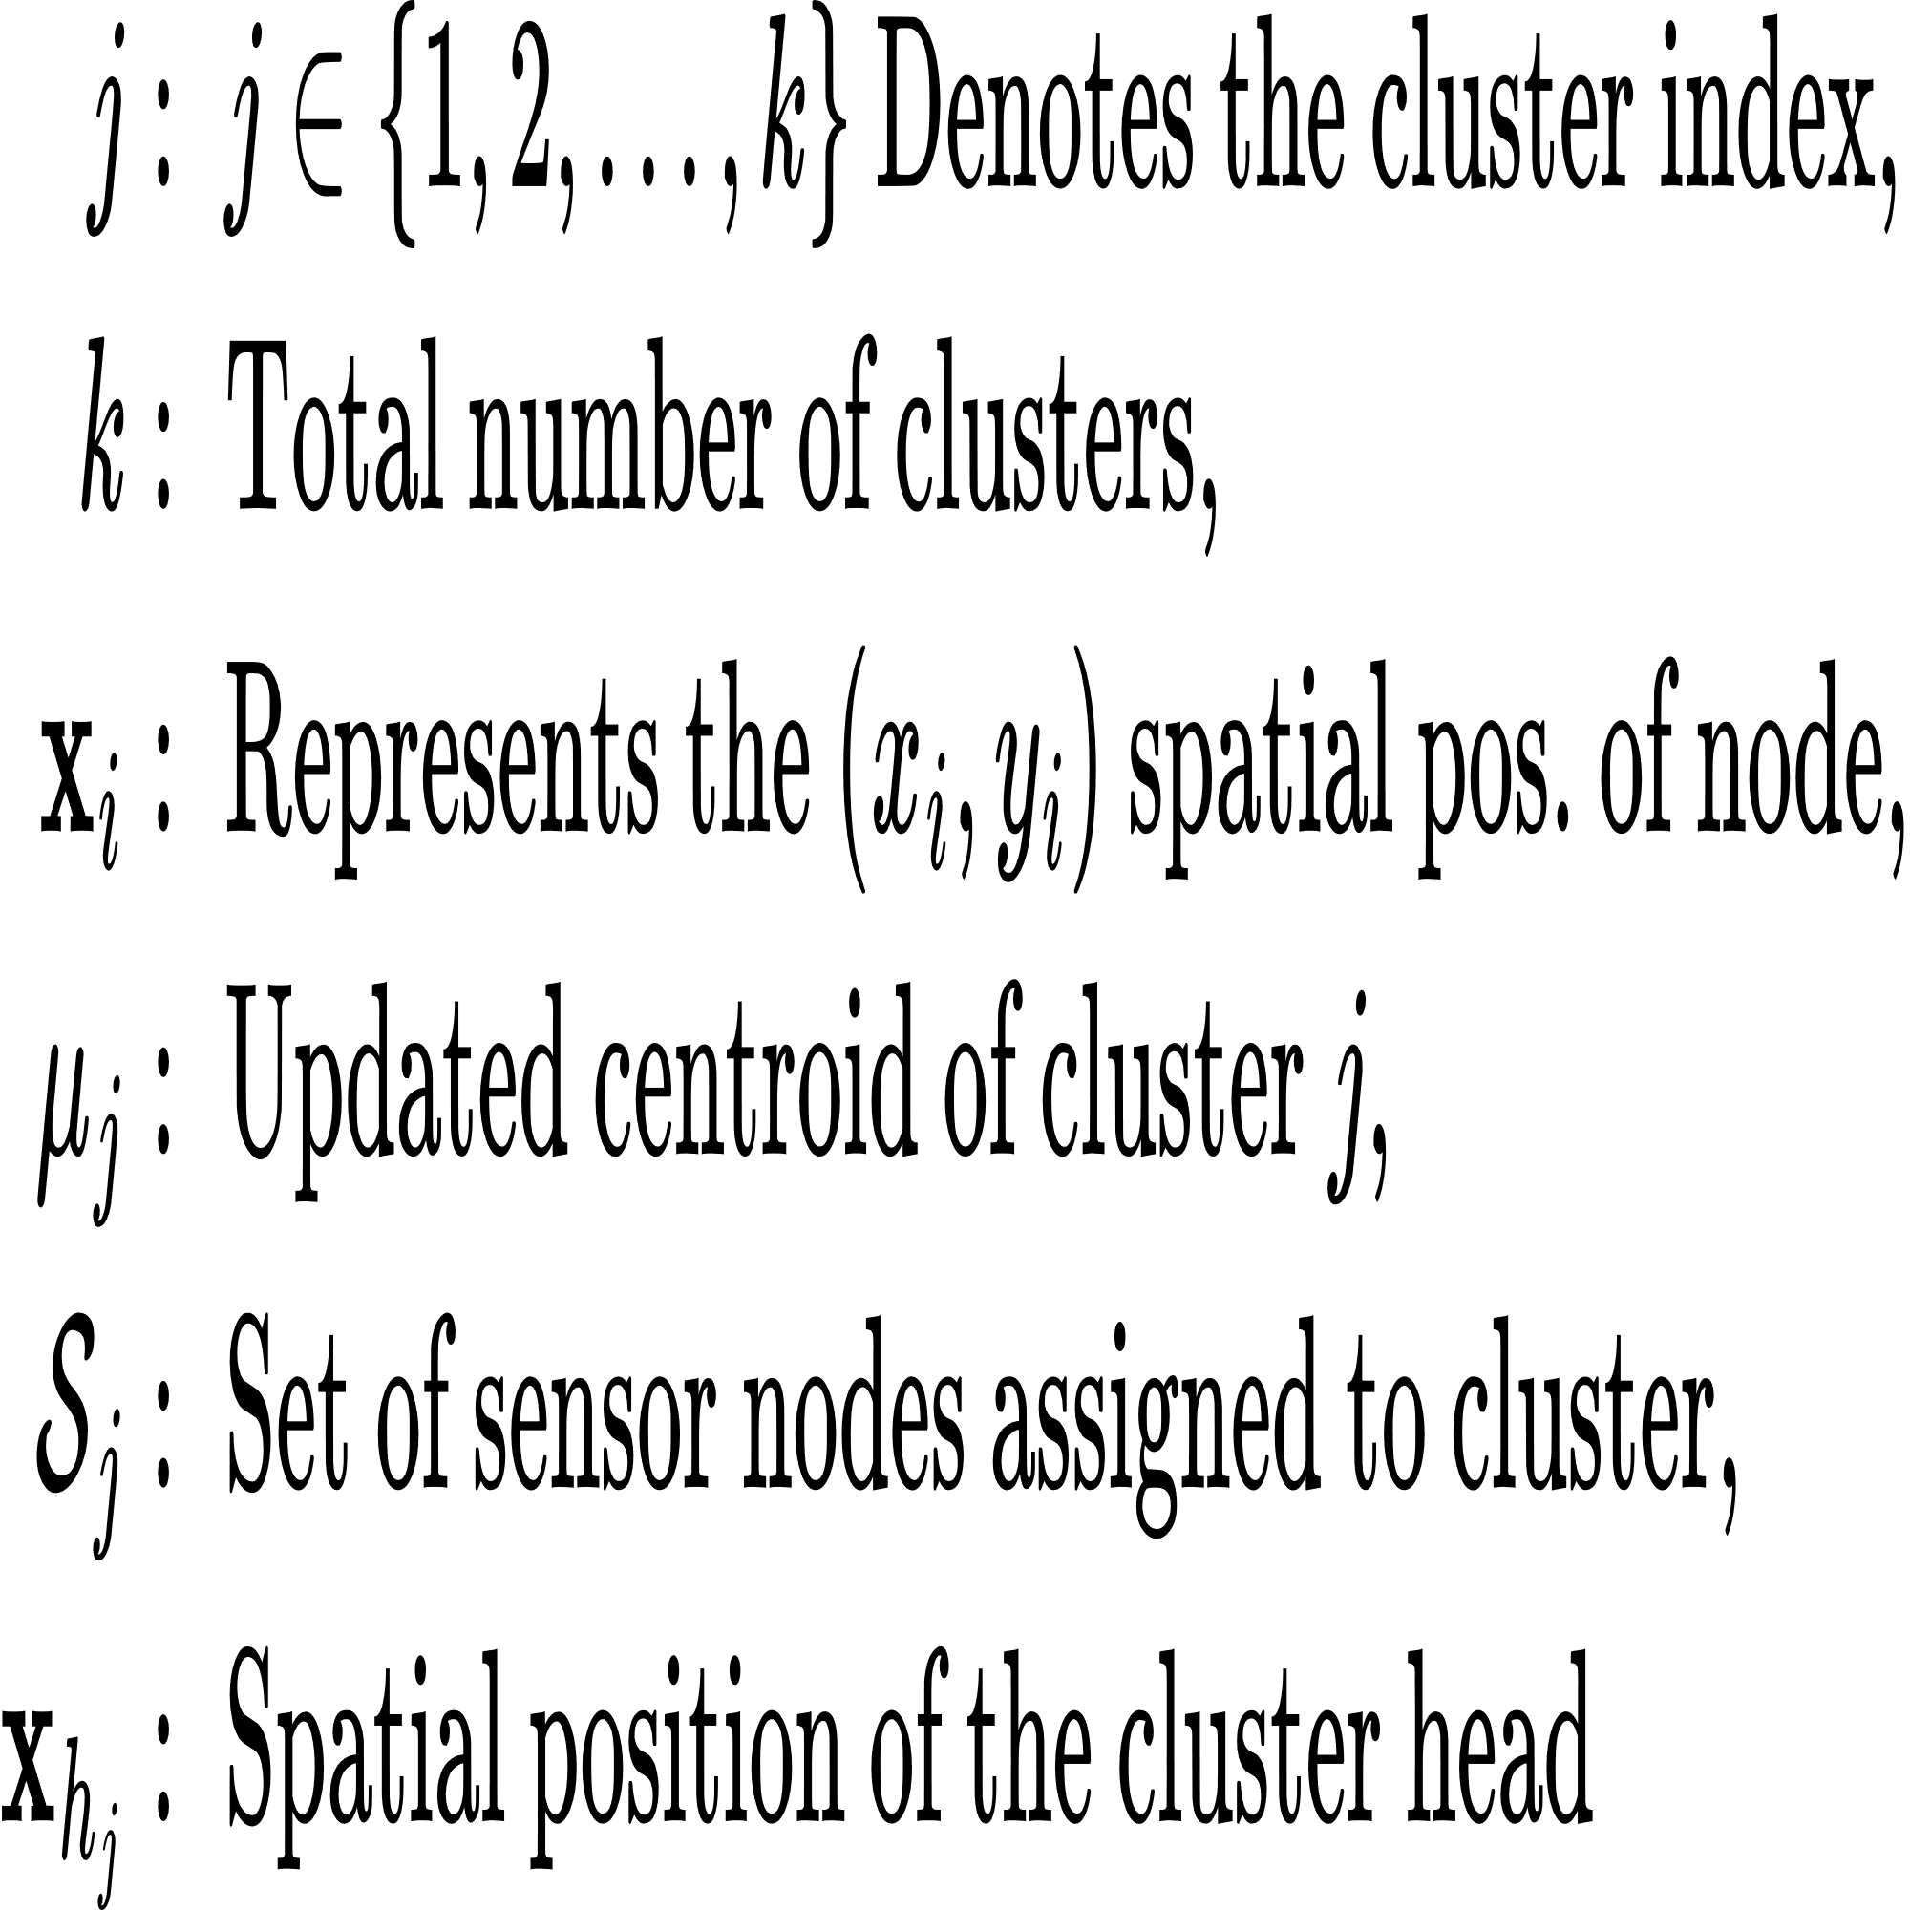
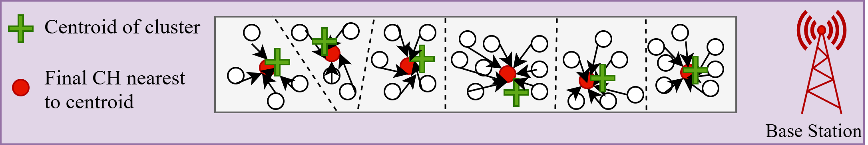
Layer 3: K-Means Algorithm
Clusters nodes into spatially compact groups based on their physical locations.
Reduces the complexity of the RL by enabling cluster level decision making instead of node level control.
The core equation that guide K-Means is:
Fig 13: K-Means Algorithm
Fig 14: Spatially compact cluster

Slide 29
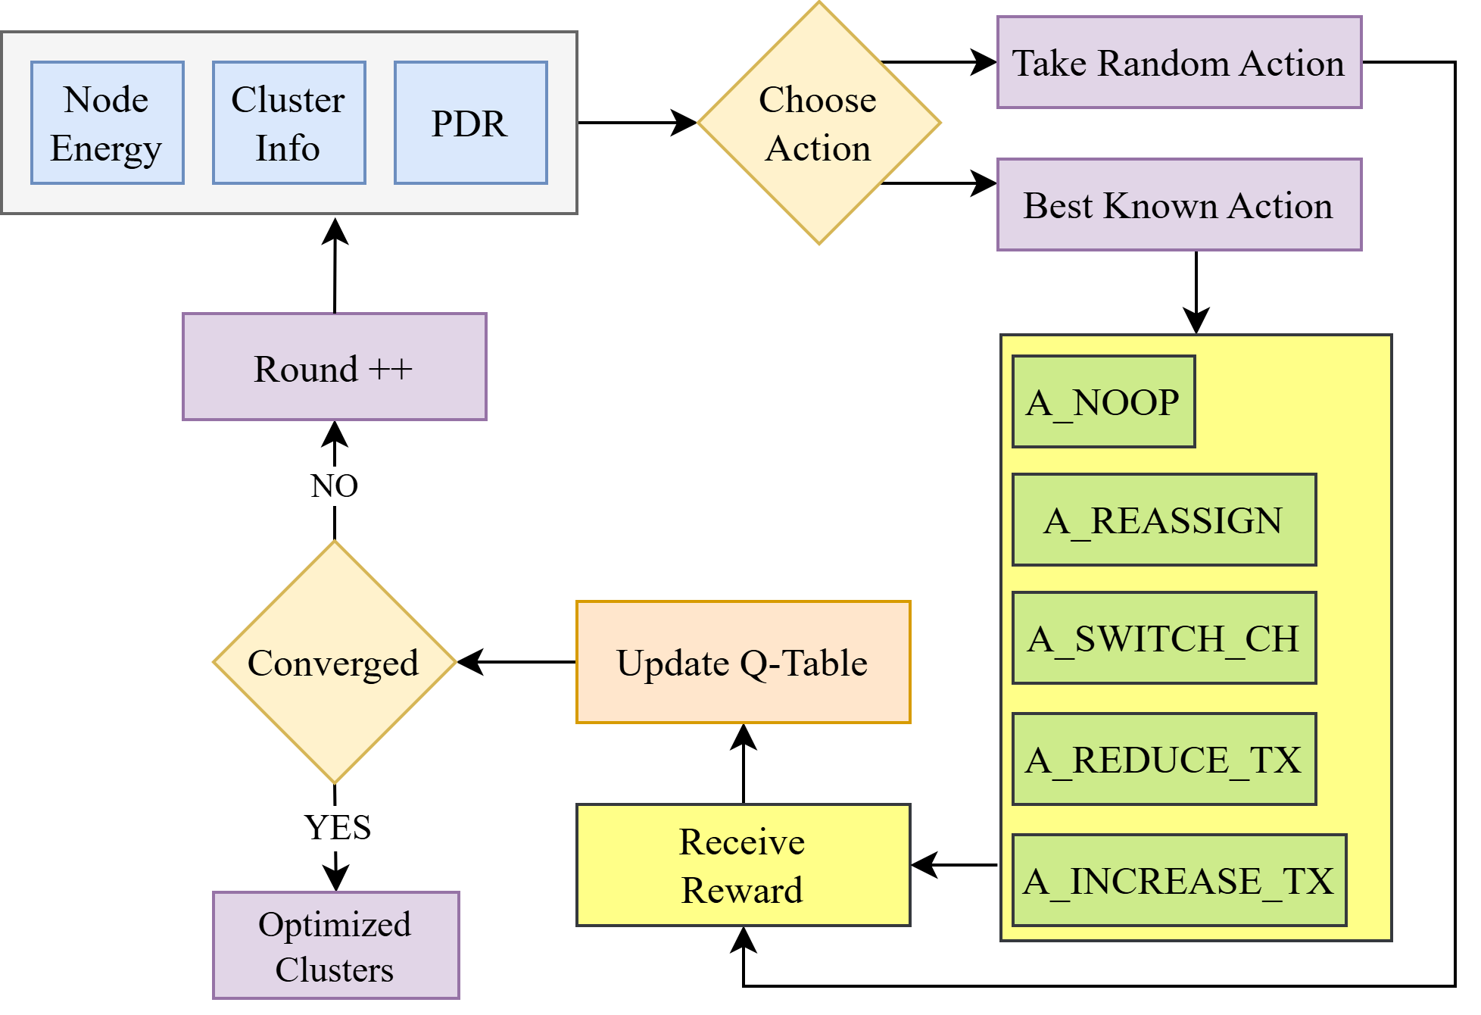
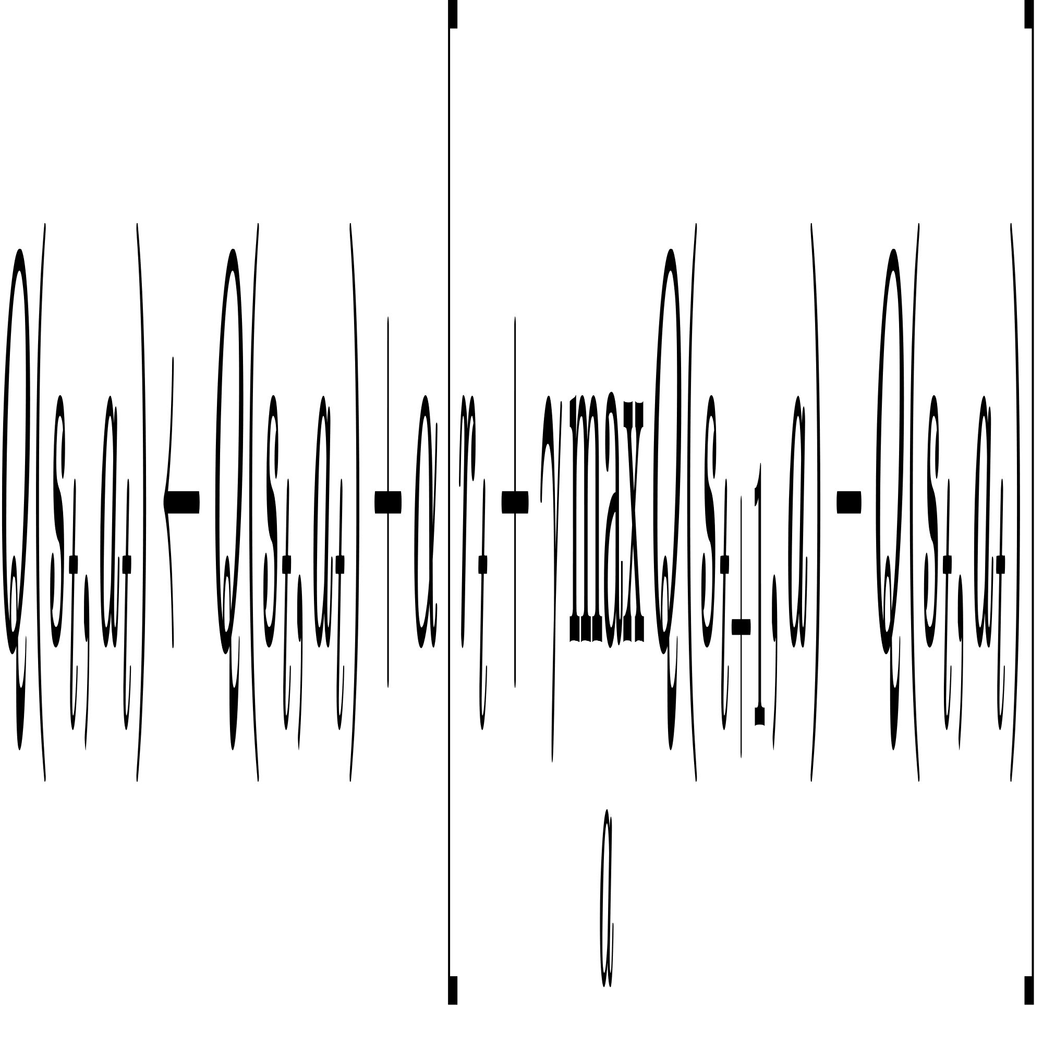
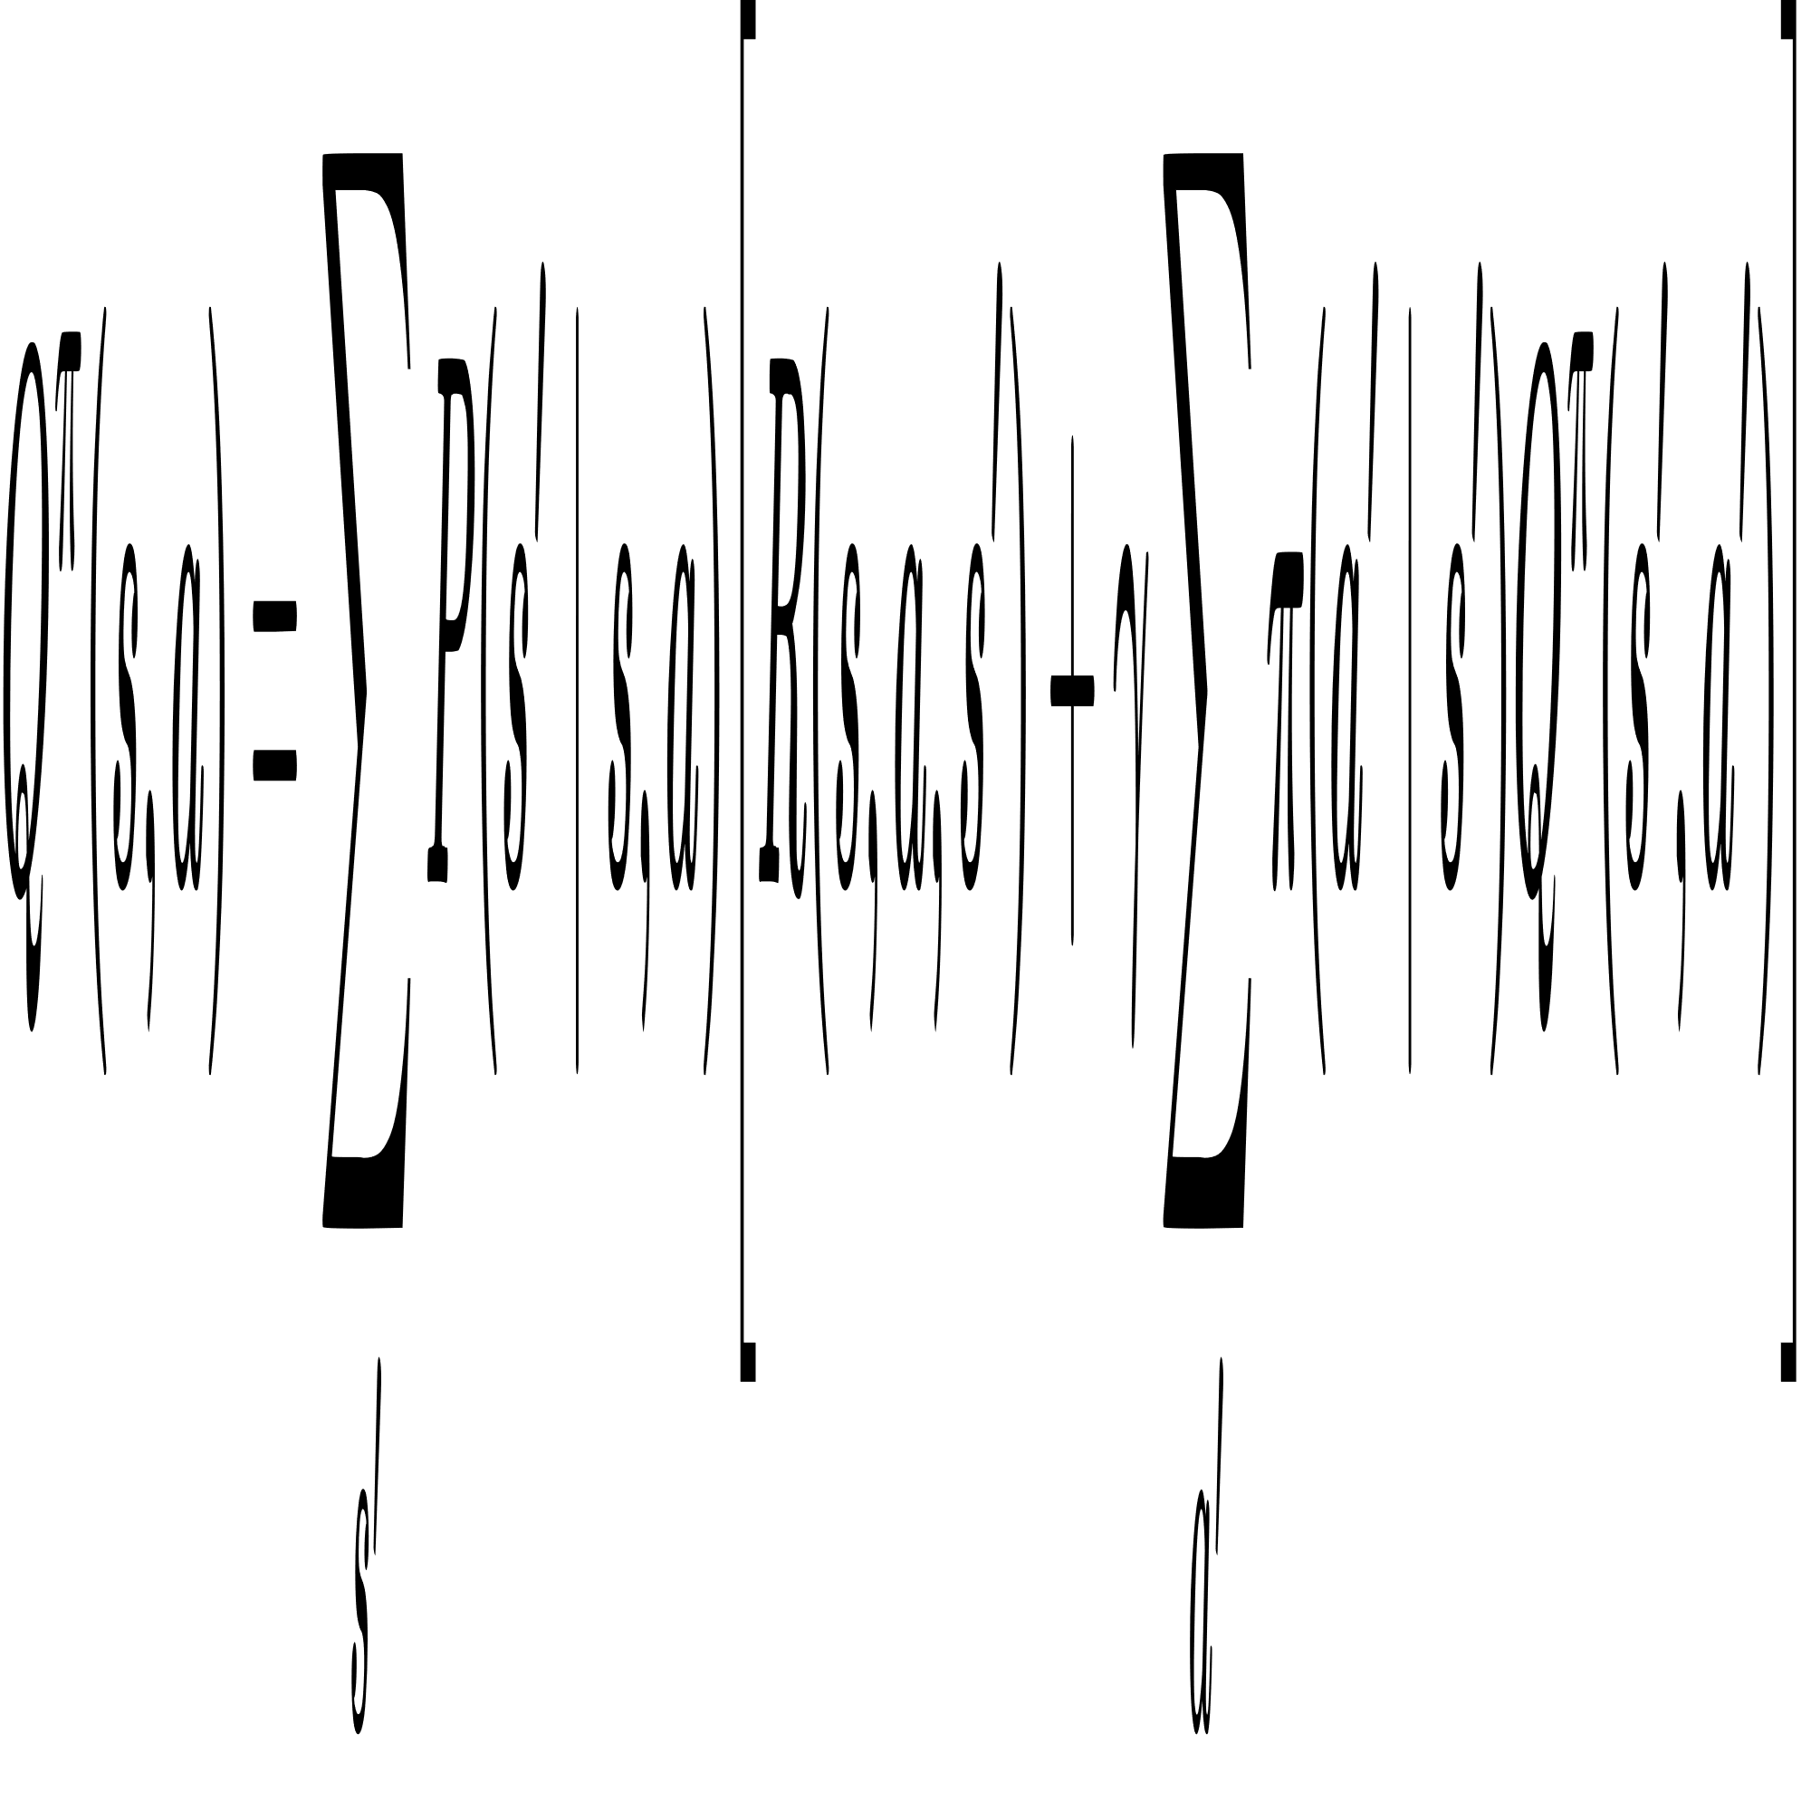
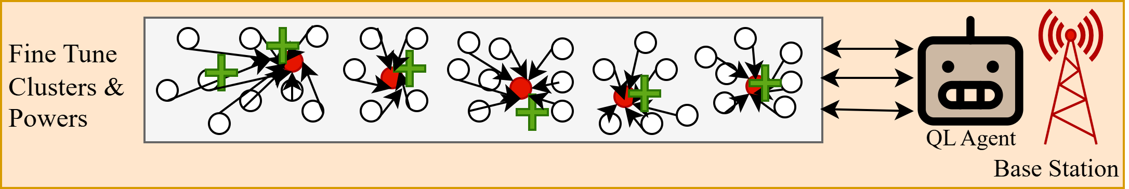
Layer 4: Reinforcement Learning Using Q-Learning
Adaptive decision making by observing network metrics (energy, cluster load, PDR) and chooses adaptive actions.
Learning from feedback by evaluating the outcome of each action using a reward function and updates the Q-table.
Fig 15: RL Algorithm
Above equations are state value function and Q-Table update formula which guide Q-Learning.
Fig 16: Centralized Q-Learning Agent Optimizing Cluster Formation

Slide 30
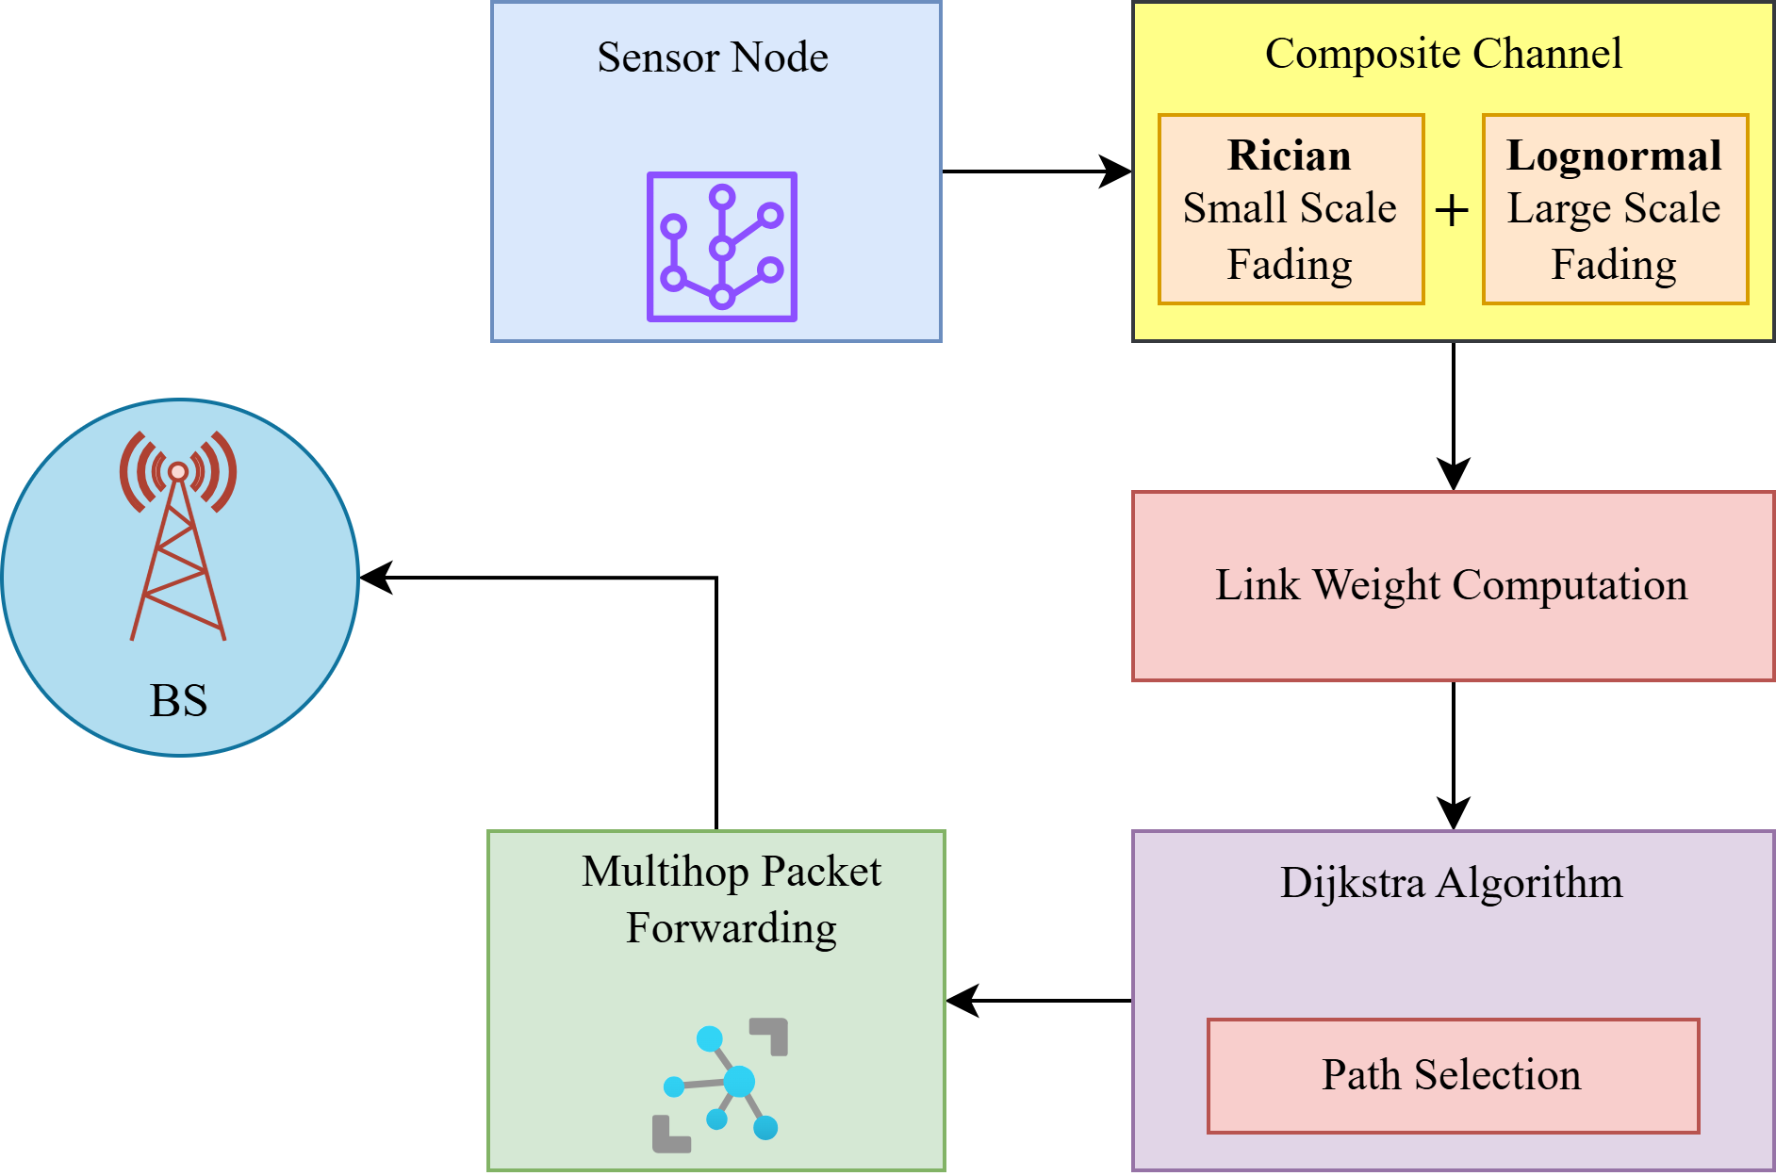
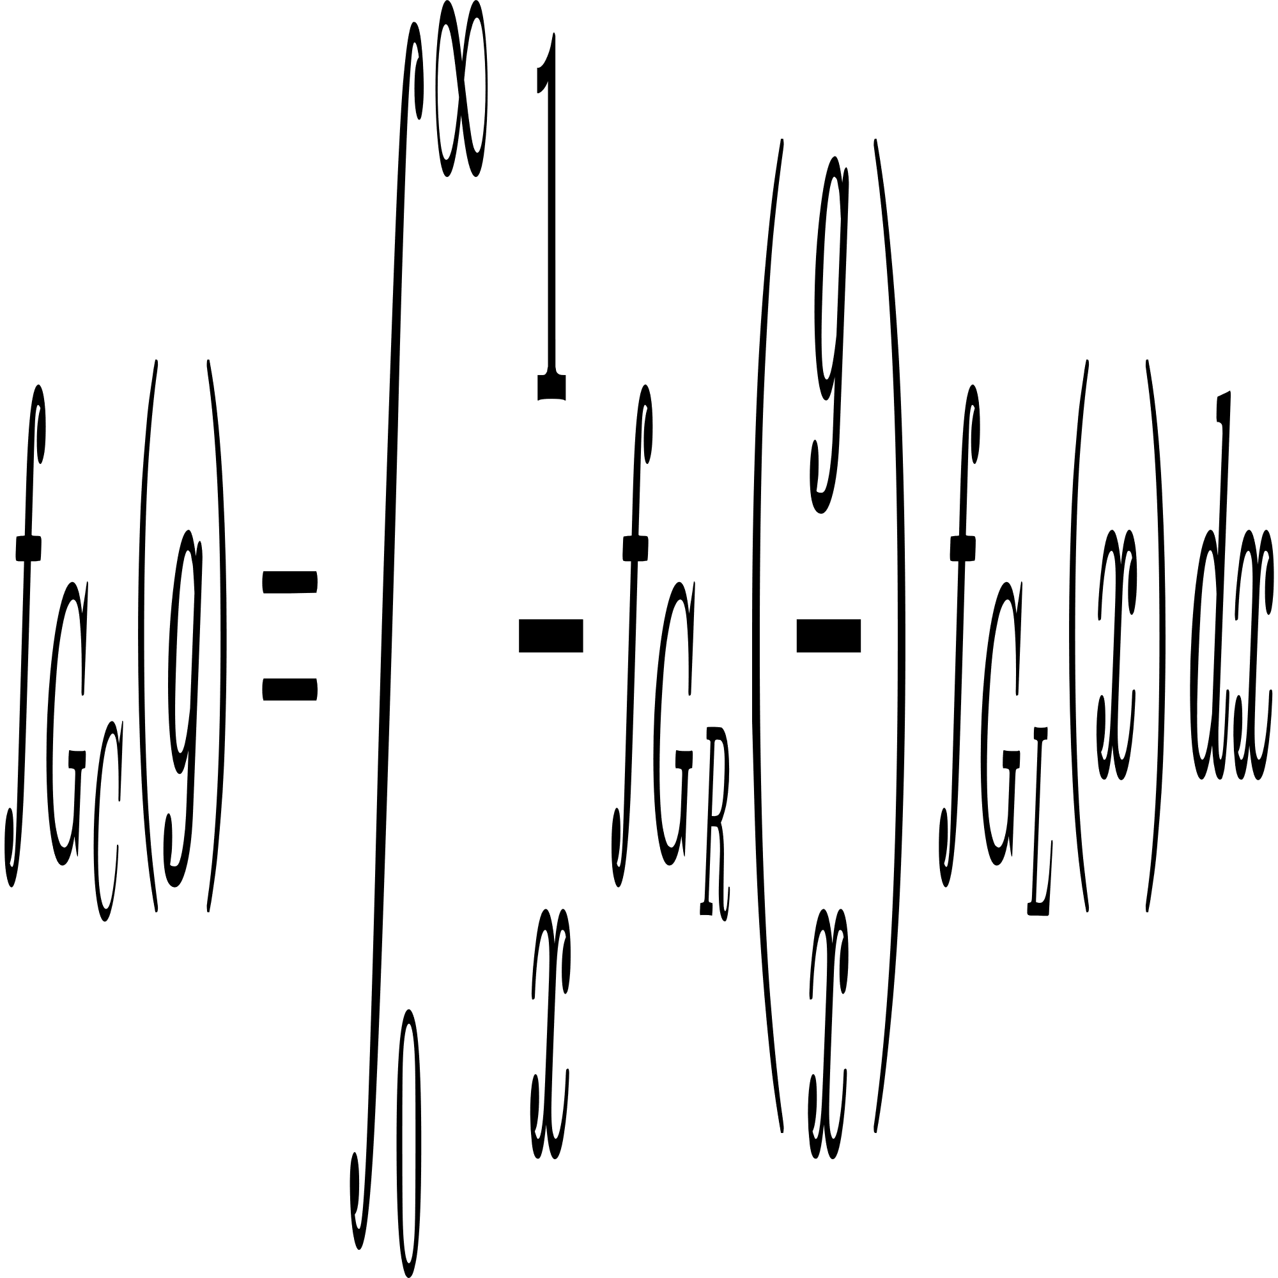
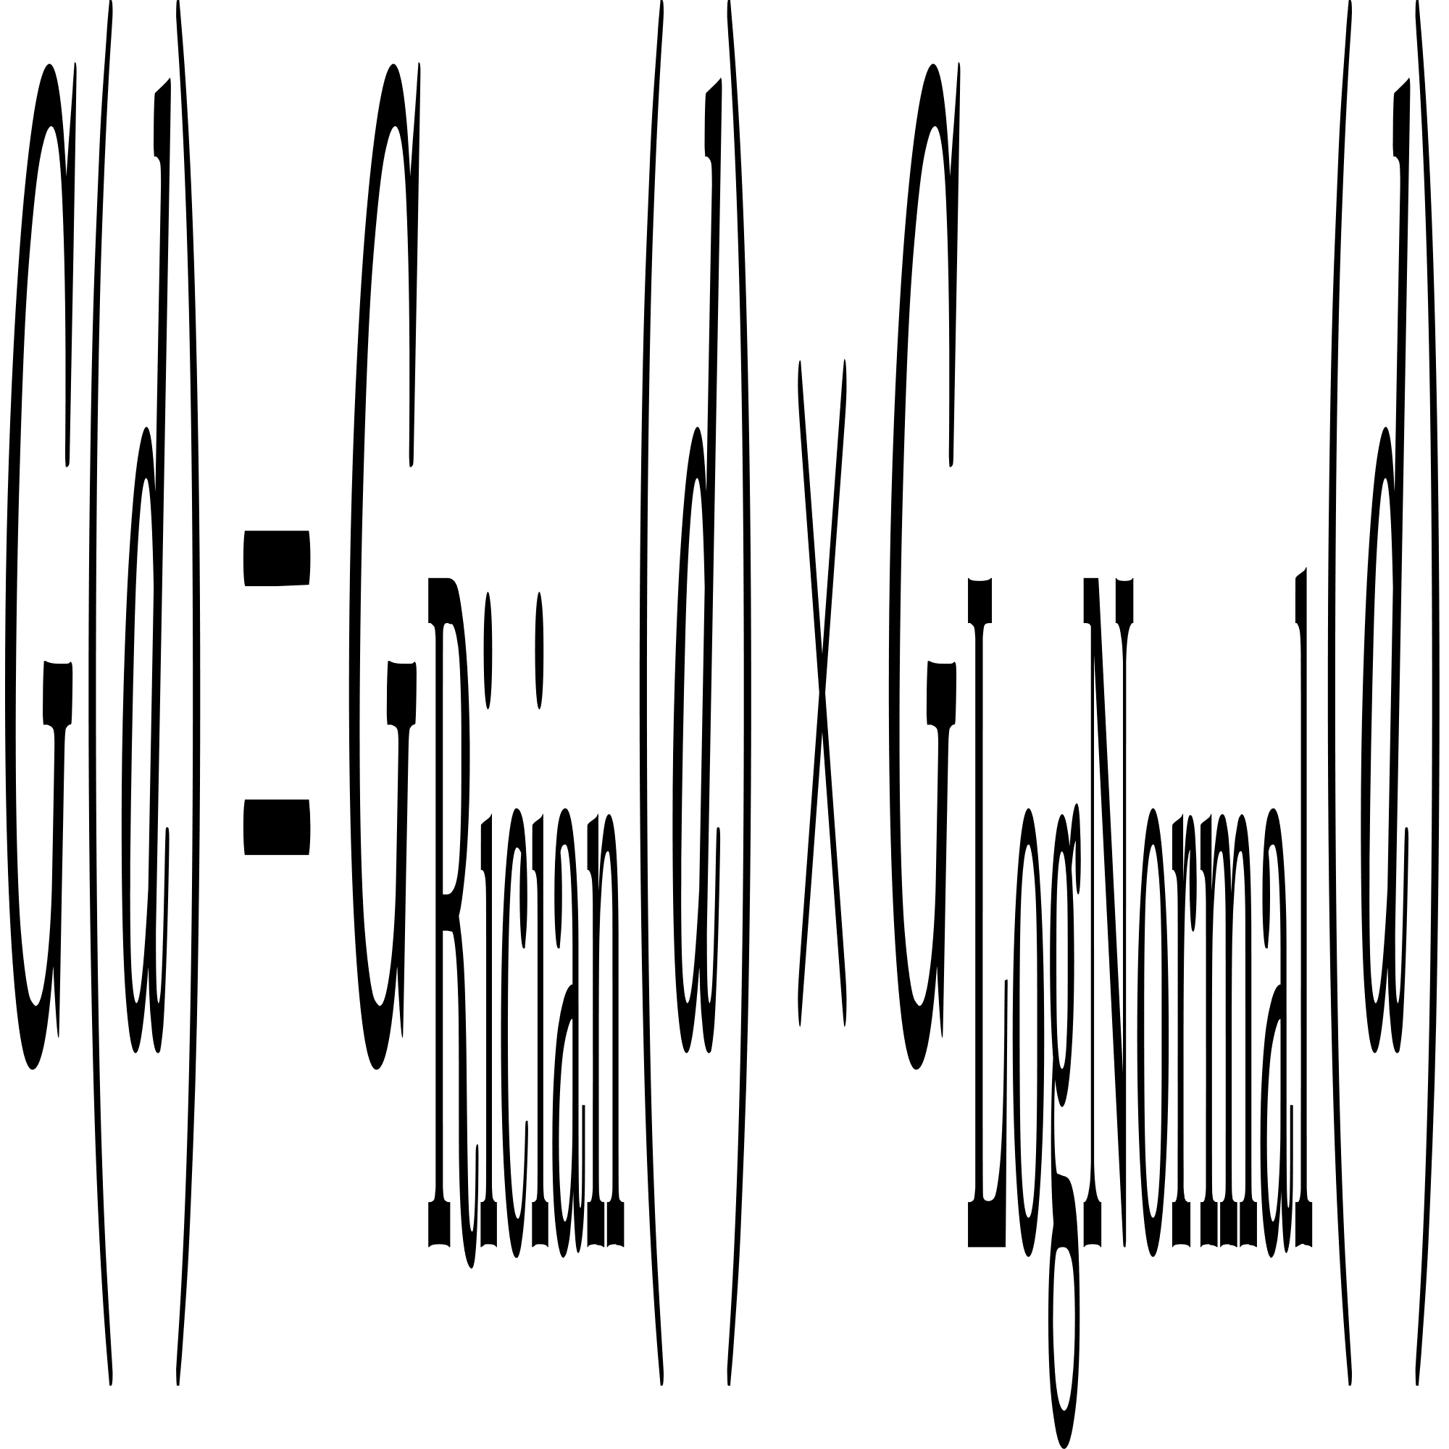
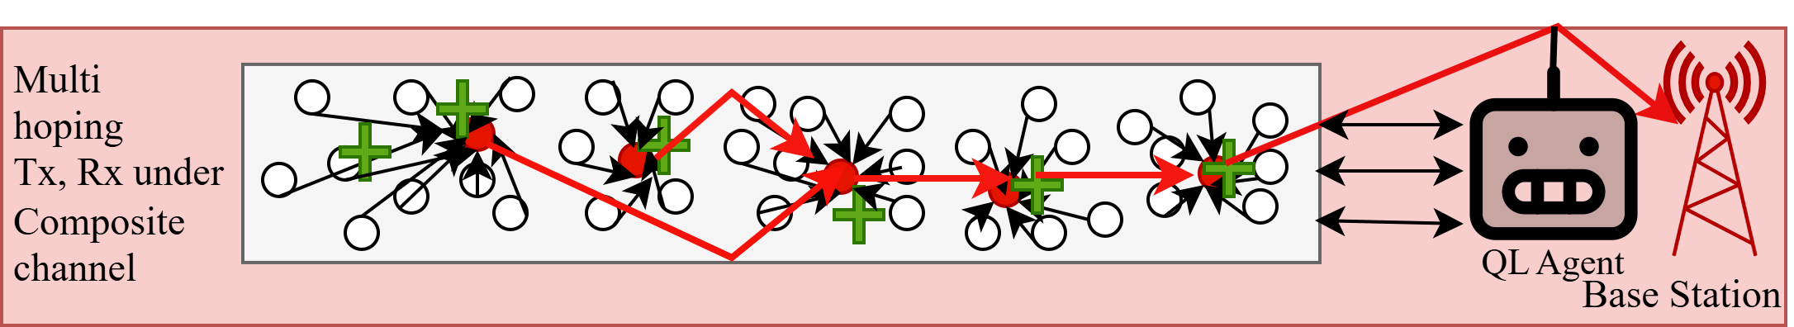
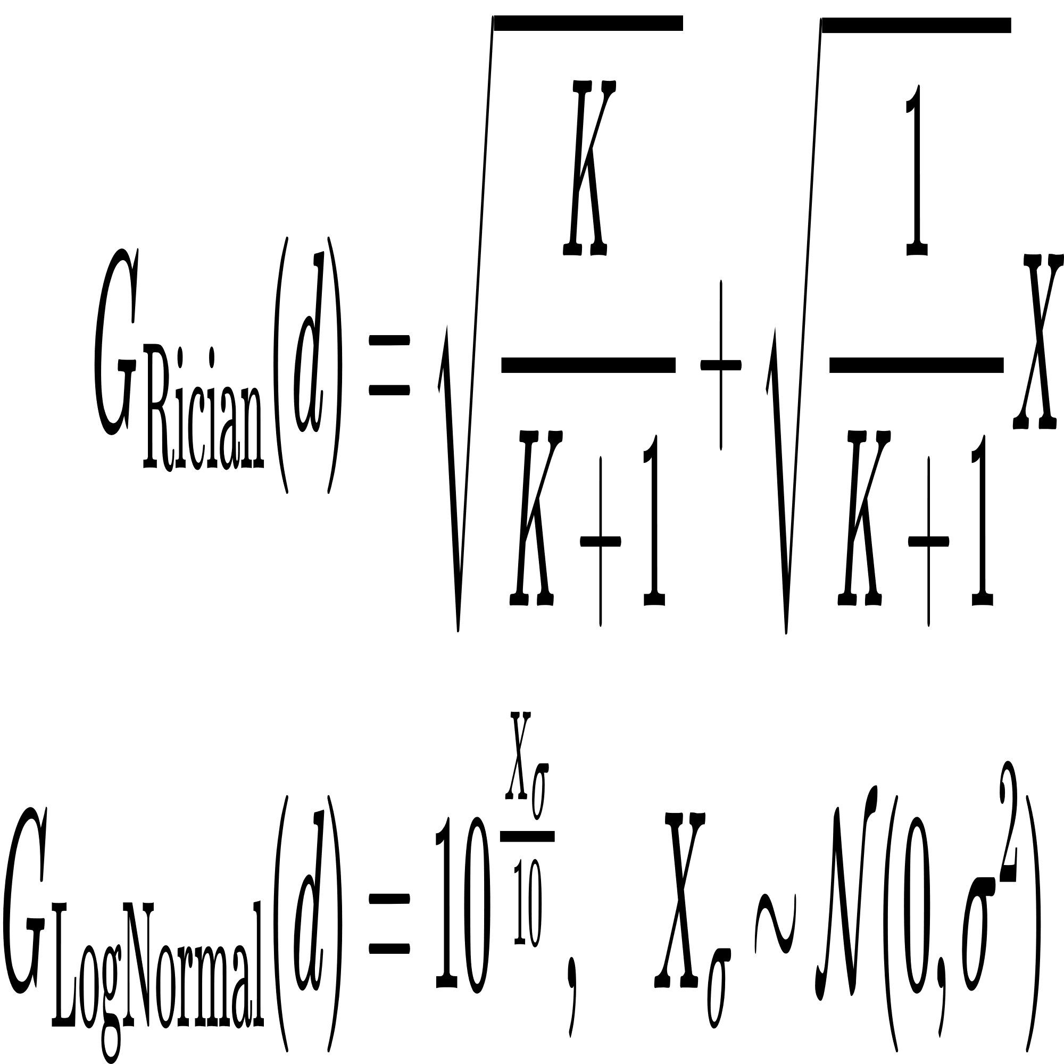
Layer 5: Communication Management
Multihop Routing using Dijkstra Algorithm: Determines the optimal paths for data packets from sensor nodes to the sink.
Uses Rician for small scale variations and Log Normal shadowing for large scale effects to compute realistic channel link gains.
The core equations which guide Composite channel:
Fig 17: Communication
Fig 18: Multihopping communication under composite channel

Slide 31
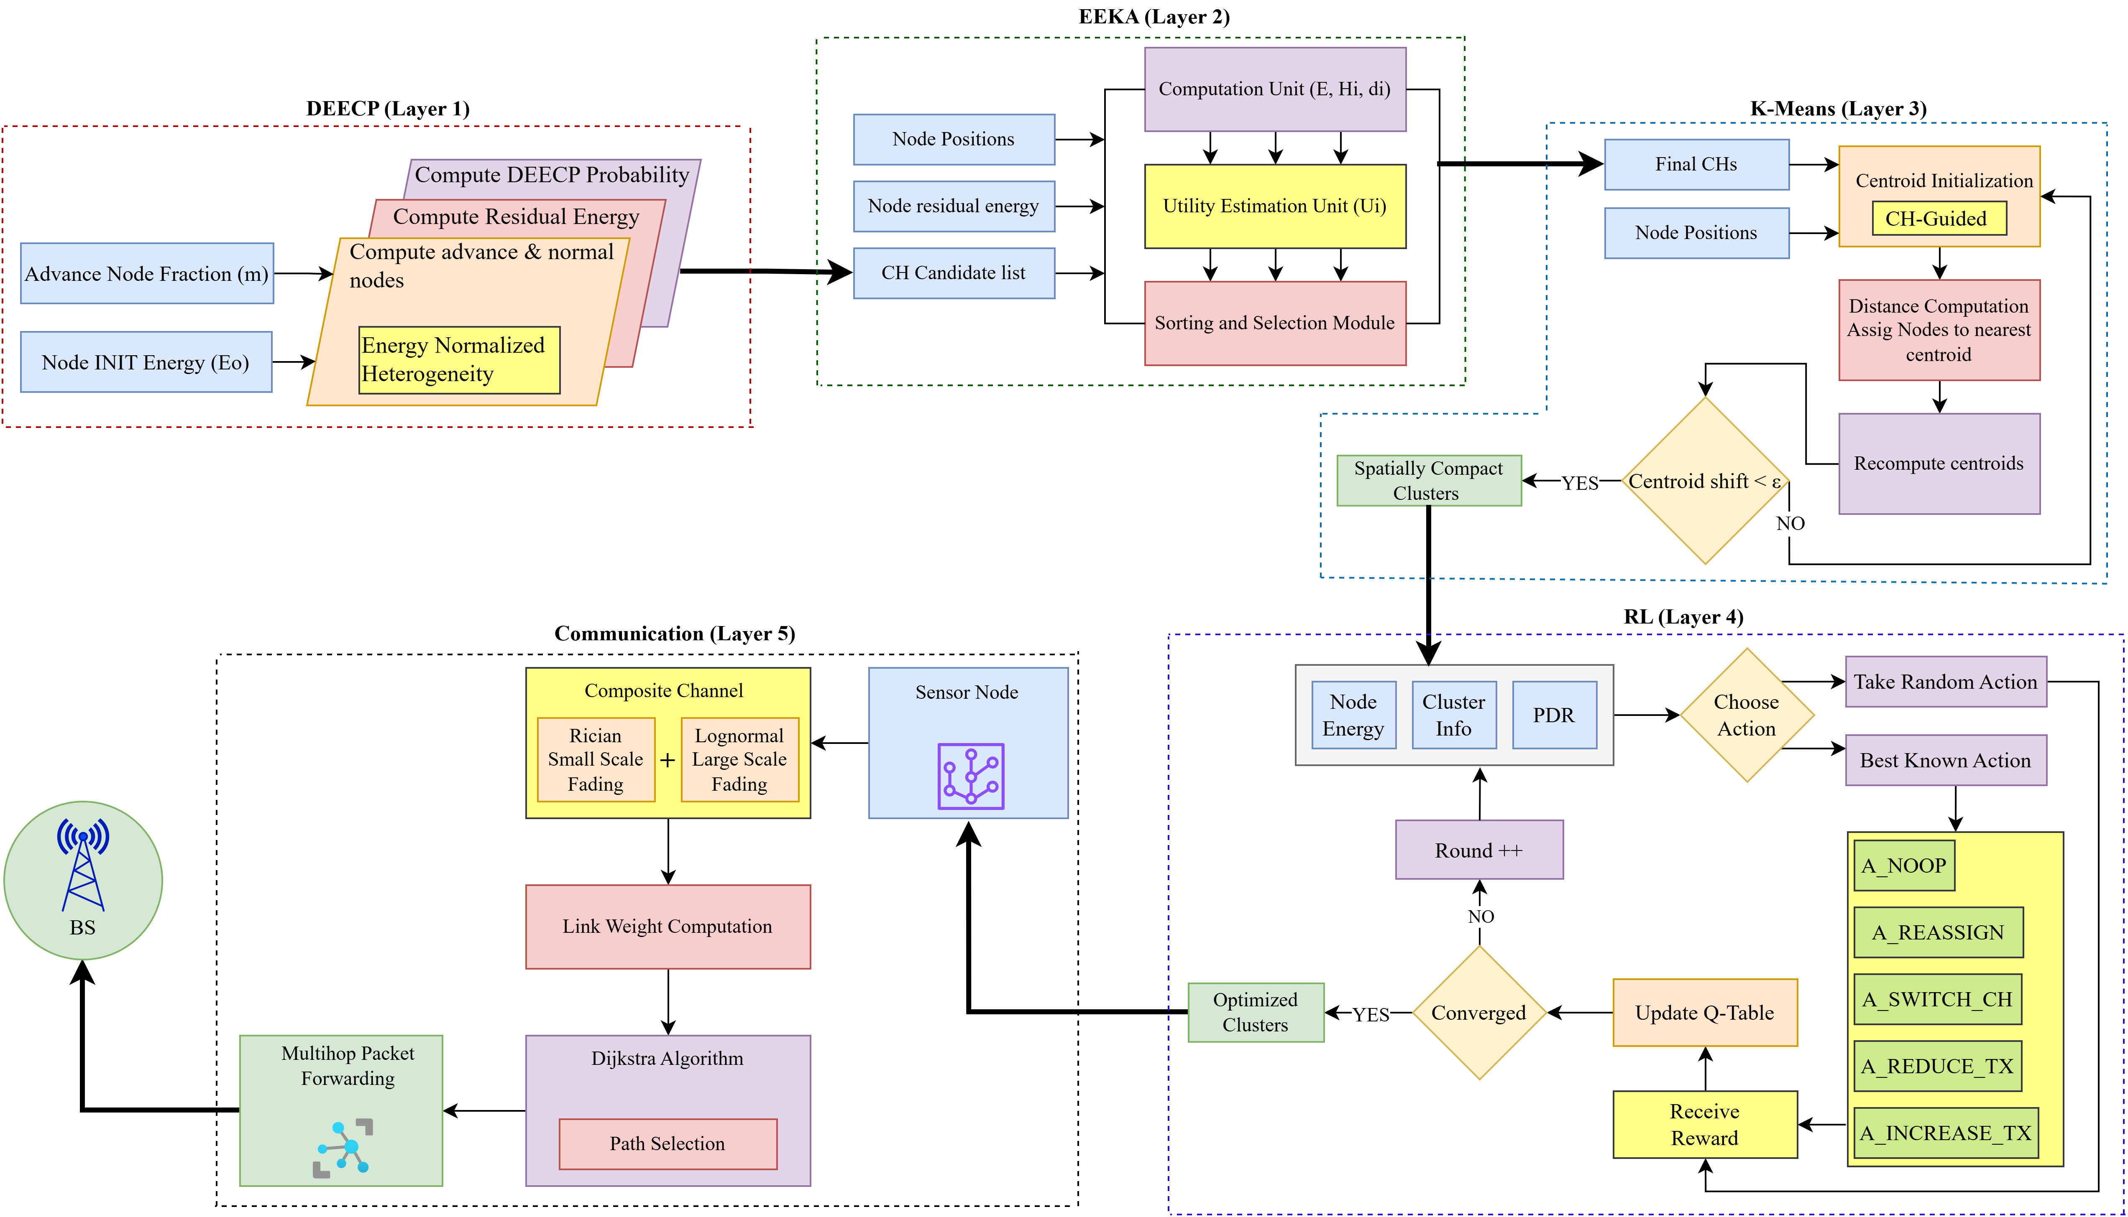
Fig 19: End-to-End Layer Integration

Slide 32
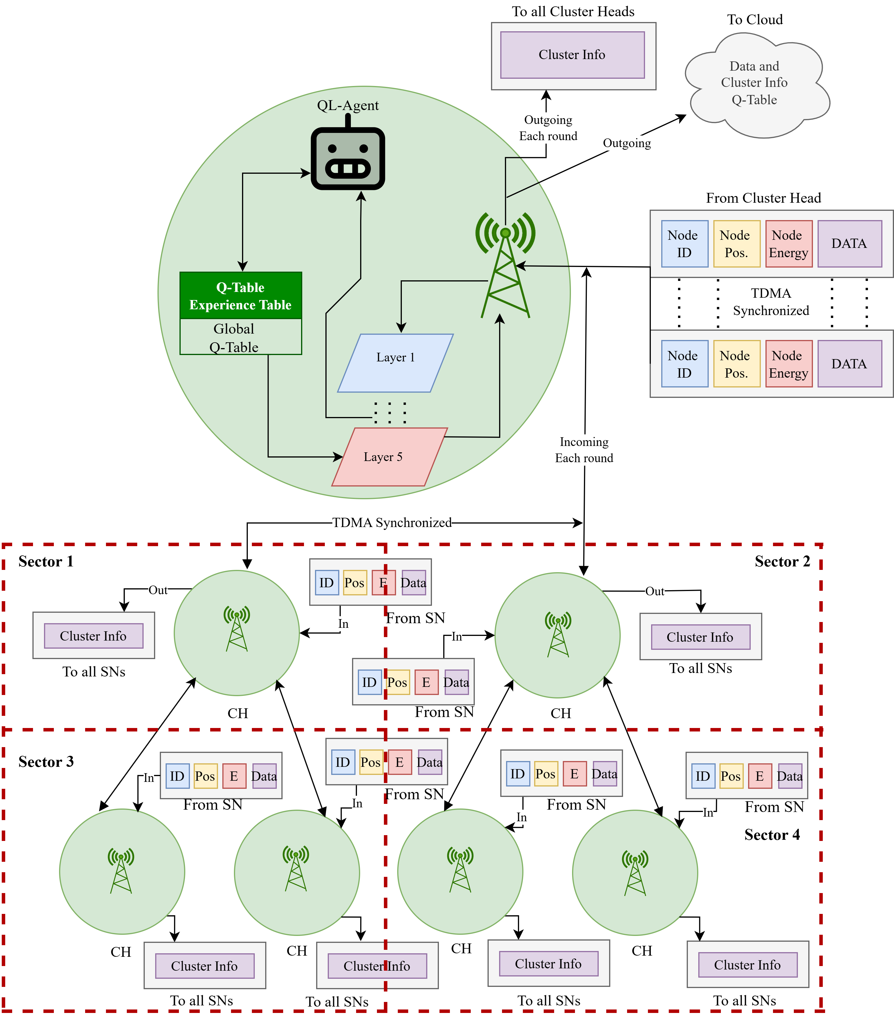
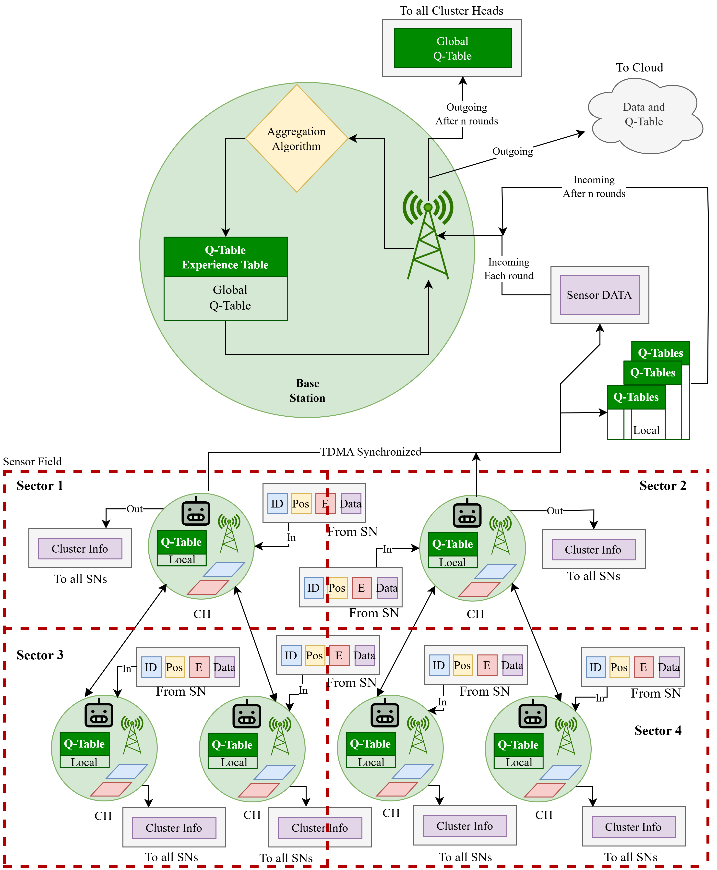
Fig 20: Centralized Q-learning
Fig 21: Federated Q-learning

Slide 33
Simulation Environment
Network Parameters | Value
WSN area size | 1000m x 1000m
Initial energy | 2 Joules
Number of Sensor Nodes | 150
Packet size | 128 bytes (1024 bits)
Data aggregation energy | 5n J/bit/signal
Transmit energy | 50n J/bit
Receive energy | 50n J/bit
Free space loss | 10n J/bit
Multipath loss | 0.0013p J/bit
Base Station Mobility | Fixed / Mobile
Network Type | Heterogeneous WSN
Simulation Rounds | 1000-4000
Node and Sink Model | Value
Node Mobility | Random Walk
Maximum Node Speed | 1 m/s
Sectorization | 3 × 3 grid (9 sectors)
Underground Channel Model | Value
Channel Type | Composite channel
Operating Frequency | 865 MHz (LoRa)
Noise Power | −95 dBm
Application/Software | Version
Python | 3.11.1
Antigravity | A1

Slide 34
Network Simulation
This animation illustrates the dynamic behavior of the wireless sensor network over successive simulation rounds.
It shows cluster head rotation, sector wise operation and multi-hop routing while nodes are mobile
Fig 22: RLHC (CEN) simulation

Slide 35
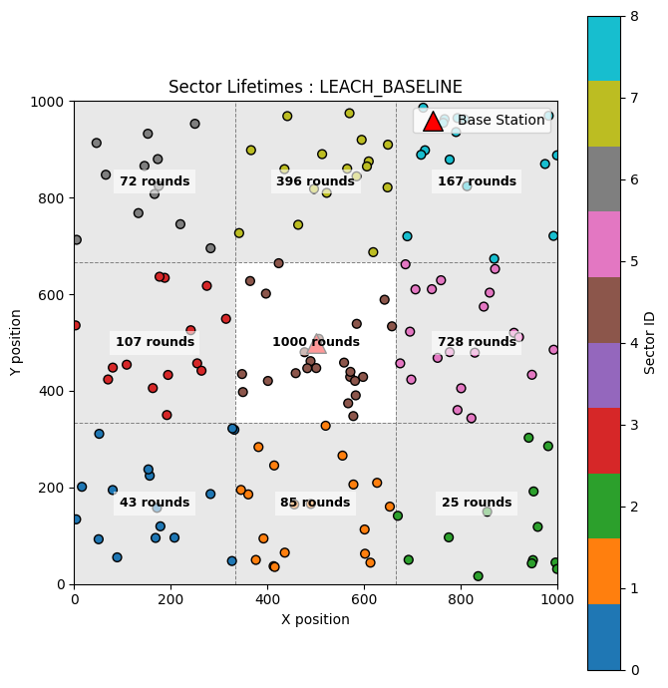
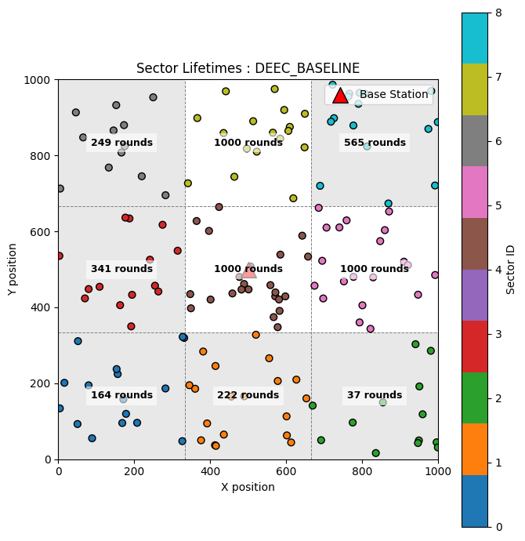
Simulation Results
Fig 23: Sector-wise survival in LEACH
Fig 24: Sector-wise survival in DEECP

Slide 36
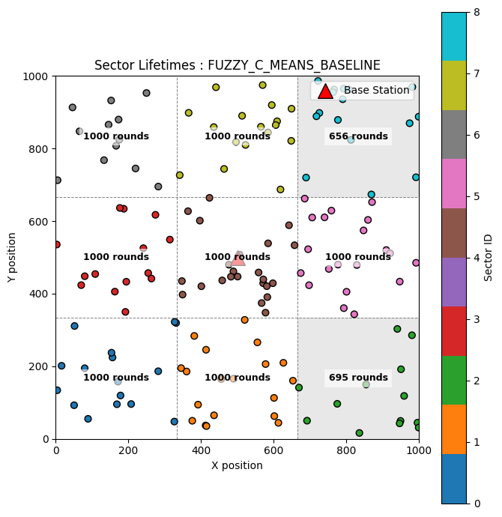
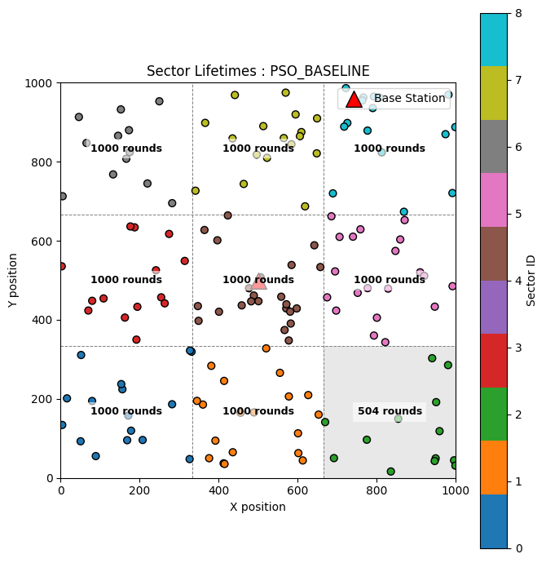
Simulation Results
Fig 25: Sector-wise survival in FCM
Fig 26: Sector-wise survival in PSO

Slide 37

Simulation Results
Fig 27: Sector-wise survival in FCM

Slide 38
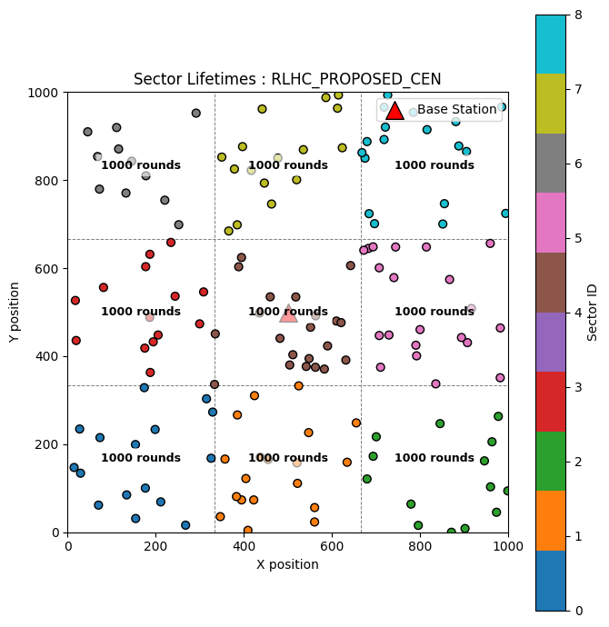
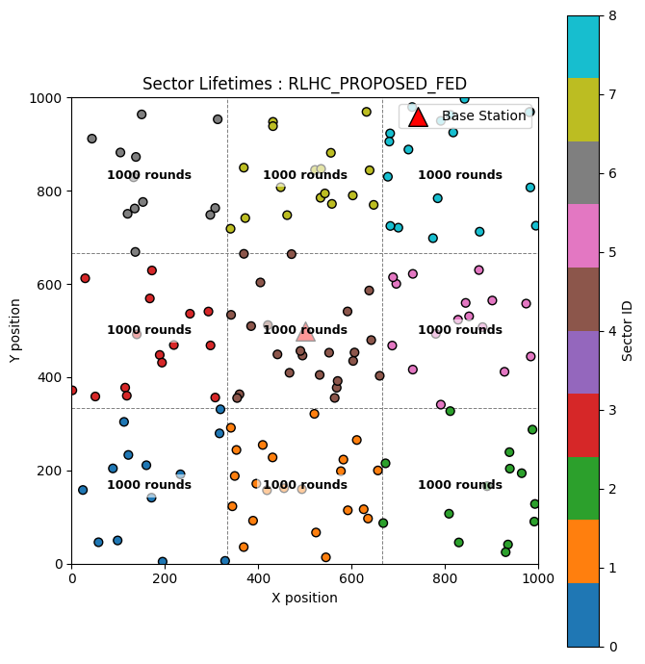
Simulation Results
Fig 28: Sector-wise survival in RLHC (Centralized)
Fig 29: Sector-wise survival in RLHC (Federated)

Slide 39
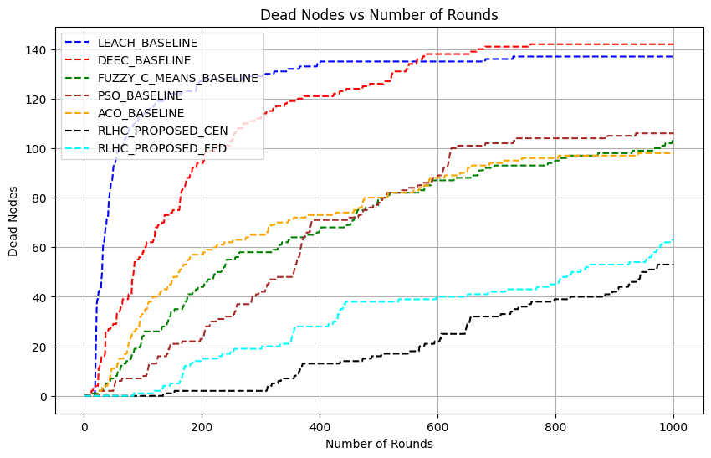
Simulation Results
Fig 30: Network lifetime in terms of node death

Slide 40
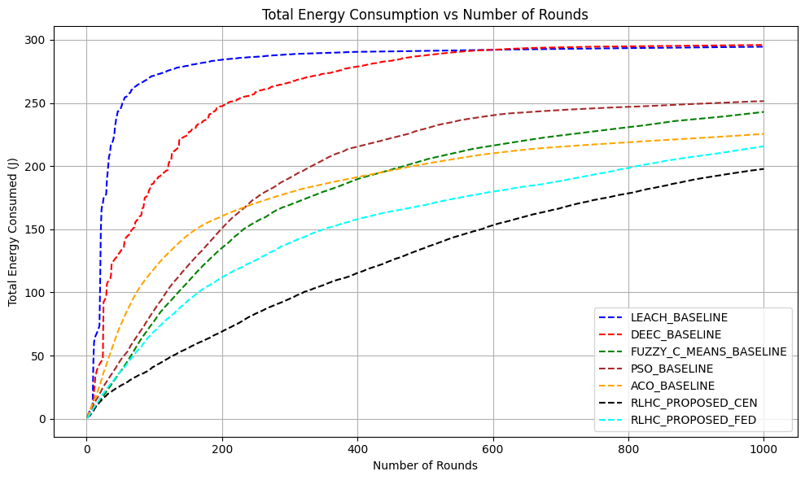
Simulation Results
Fig 31: Total Energy Consumption

Slide 41
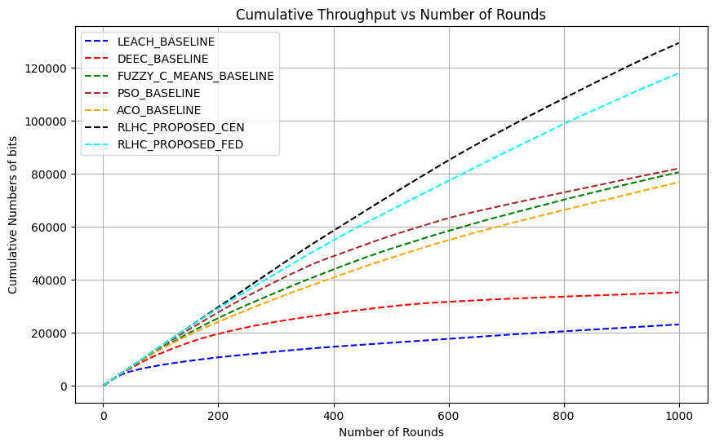
Simulation Results
Fig 32: Total Throughput

Slide 42
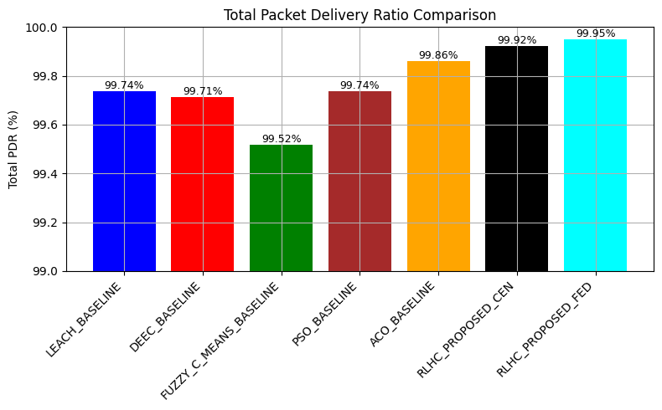
Simulation Results
Fig 33: Average PDR

Slide 43
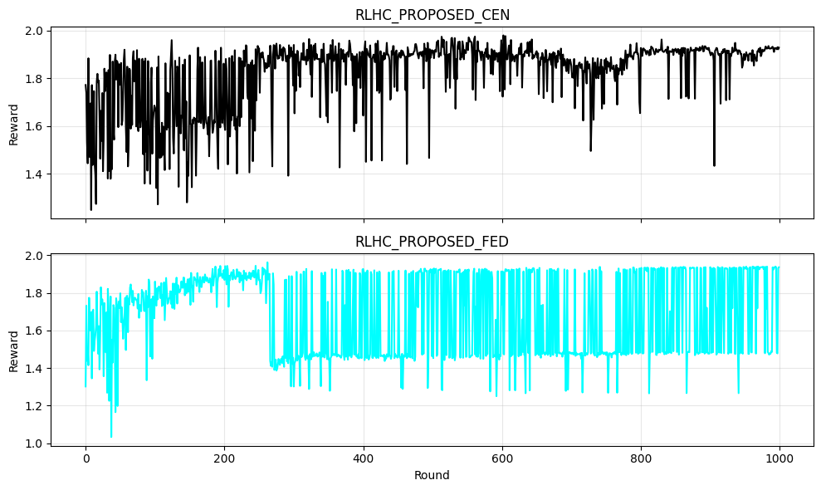
Simulation Results
Fig 34: Q-Learning Reward

Slide 44
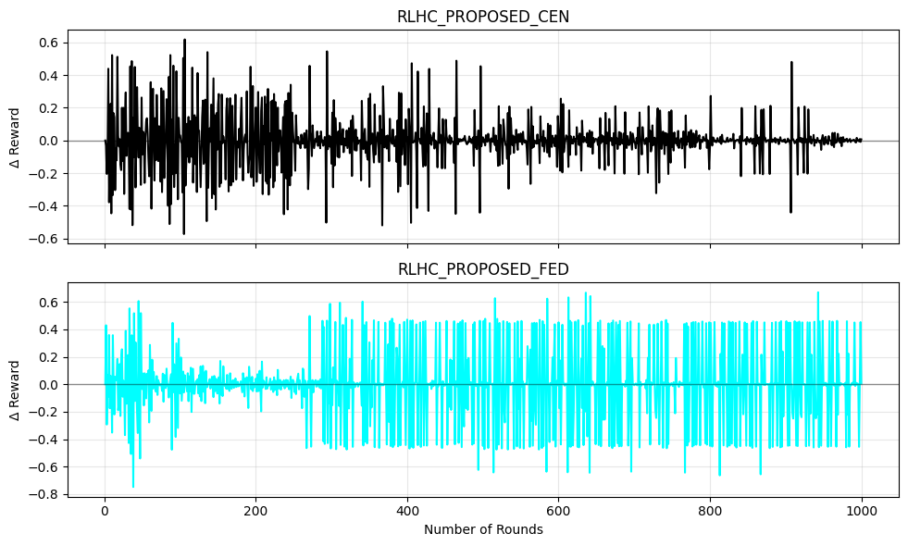
Simulation Results
Fig 35: Q-Learning Reward variation from previous round

Slide 45


Simulation Results
Fig 36: Sector-wise survival in RLHC (CEN)
Fig 37: Sector-wise survival in RLHC (FED)

Slide 46

Simulation Results
Fig 38: Network lifetime in terms of node death

Slide 47

Simulation Results
Fig 39: Total Energy Consumption

Slide 48

Simulation Results
Fig 40: Total Throughput

Slide 49

Simulation Results
Fig 41: Average PDR

Slide 50

Simulation Results
Fig 42: Q-Learning Reward

Slide 51

Simulation Results
Fig 43: Q-Learning Reward variation from previous round

Slide 52
Result Summary
Table 2: Comparision table for 1000 rounds of simulation for 150 nodes
Simulation for 1000 rounds
Methods | Sector Survived | No.dead nodes | Energy Usage (J) | Throughput (kbps) | Avg PDR (%)
LEACH | 1/9 | 138/150 | 297/300 | 22 | 99.74
DEEC | 3/9 | 142/150 | 295/300 | 38 | 99.71
PSO | 8/9 | 108/150 | 251/300 | 81 | 99.74
ACO | 8/9 | 94/150 | 220/300 | 77 | 99.86
FCM | 7/9 | 107/150 | 240/300 | 80 | 99.52
RLHC (Centralized) | 9/9 | 55/150 | 197/300 | 133 | 99.92
RLHC (Federated) | 9/9 | 62/150 | 214/300 | 118 | 99.95
Table 3: Comparision table for 4000 rounds of simulation for 150 nodes
Simulation for 4000 rounds
Methods | Sector Survived | No.dead nodes | Energy Usage (J) | Throughput (kbps) | Avg PDR (%)
RLHC (Centralized) | 1/9 | 140/150 | 297/300 | 260 | 99.87
RLHC (Federated) | 3/9 | 130/150 | 286/300 | 250 | 99.97

Slide 53
Conclusion
Unmatched Sector Survivability: RLHC is the only framework where all 9 sectors remain alive for 1000 rounds, ensuring continuous sensing coverage.
RLHC Superior Lifetime & Energy Efficiency
+57% network lifetime vs. LEACH / DEEC
+45% lifetime vs. PSO / ACO / FCM
+33% energy savings vs. LEACH / DEEC
+16% energy savings vs. PSO / ACO / FCM
RLHC High Throughput with Reliable Delivery
+240% throughput vs. LEACH / DEEC
+50% throughput vs. PSO / ACO / FCM
Improved Avg. PDR across all comparisons
Final Insight: Federated RLHC delivers the best balance of stability, energy efficiency and reliability, making it a strong candidate for safety-critical underground mining applications. Compared to the centralized variant, it sustains 3 surviving sectors (vs. 1), achieves 8% longer network lifetime and 3.5% better energy efficiency, while the centralized RLHC attains only a slightly higher short-term throughput (+5%).

Slide 54
Future Direction
Adaptive Communication Learning Trade-off: A dynamic federation intervals and adaptive model aggregation to further reduce heuristic based assumption.
Fault Tolerant & Emergency Aware Policies: It incorporate failure prediction and emergency aware reward functions to prioritize critical sectors during hazardous events (gas leaks, collapses).
Trust Aware Mechanism: It integrate trust scores for local updates, anomaly detection and weighted aggregation to suppress faulty/malicious nodes.

Slide 55
References
[1] Online Data Source: Directorate General of Mines Safety (DGMS) - https://www.dgms.gov.in
[2] Online Data Source: https://www.assocham.org/uploads/files/Study_Indian%20Mineral%202022.pdf
[3] S. Saha, S. C. Bakshi, A. Pramanik and R. Lakshmanan, "On Underground Coal Mine Environment Monitoring with LoRa Range Extension," 2023 5th International Conference on Energy, Power and Environment: Towards Flexible Green Energy Technologies (ICEPE), Shillong, India, 2023,1-6, doi: 10.1109/ICEPE57949.2023.10201552.
[4] M. Amanzadeh, S. M. Aminossadati, M. S. Kizil, E. Sheridan and W. P. Bowen, "A microfabricated fibre optic sensor for methane gas measurement in underground coal mines," 2012 Photonics Global Conference (PGC), Singapore, 2012, pp. 1-5, doi: 10.1109/PGC.2012.6457999
[5] Zhang, Y., Wang, J., Han, D. (2021). Energy-Efficient Clustering Routing Protocol Based on Weight for WSN in Coal Mine. IEEE Access, https://doi.org/10.1109/ACCESS.2021.3051200
[6] Li, P., Xu, Z., & Cui, L. (2021). WSN Coverage Optimization in Coal Mine Based on Improved Whale Optimization Algorithm. IEEE Sensors Journal, https://doi.org/10.1109/JSEN.2021.3074500
[7] Wang, L., & Liu, X. (2021). A Hybrid Energy-Efficient Routing Protocol for Underground Coal Mine Monitoring. Wireless Personal Communications, https://doi.org/10.1007/s11277-021-08521-x
[8] Chen, H., Wu, F., & Li, S. (2022). Research on Energy Balanced Routing Strategy for Coal Mine WSN based on Mobile Sink. International Journal of Distributed Sensor Networks, https://doi.org/10.1177/155014772210800
[9] Ahmadreza Entezari, (2019) Coverage and rate analysis in cellular networks with Nakagami-Lognormal fading channel ISSN 1874-4907,https://doi.org/10.1016/j.phycom.2019.100757. Sciencedirect article

Slide 56
References
[10] Kumar, S., & Pal, A. (2022). Fuzzy Logic Based Clustering Algorithm for WSN in Underground Mines. Applied Soft Computing, https://doi.org/10.1016/j.asoc.2022.108500
[11] B. R. Al-Kaseem, Z. K. Taha, S. W. Abdulmajeedand H. S. Al-Raweshidy, “Optimized energy–efficient path planning strategy in WSN with multiple mobile sinks,” IEEE Access, vol. 9, pp. 79994–80007, Jun. 2021, doi: 10.1109/ACCESS.2021.3087086
[12] R. Alsaqour, E. S. Ali, R. A. Mokhtar, R. A. Saeed, H. Alhumyaniand M. Abdelhaq, “Efficient energy mechanism in heterogeneous WSNs for underground mining monitoring applications,” IEEE Access, vol. 10, pp. 100123–100138, Jul. 2022, doi: 10.1109/ACCESS.2022.3188654.
[13] F. M. Salman, A. A. Mohammedand A. F. Mutar, “Optimization of LEACH protocol for WSNs in terms of energy efficiency and network lifetime,” Journal of Cyber Security and Mobility, IEEE vol. 12, no. 3, pp. 275–296, May 2023, doi: 10.13052/jcsm2245-1439.1232.
[14] M. Gamal, N. E. Mekky, H. H. Solimanand N. A. Hikal, “Enhancing the lifetime of wireless sensor networks using fuzzy logic LEACH technique-based particle swarm optimization,” IEEE Access, vol. 10, pp. 36935–36948, Mar. 2022, doi: 10.1109/ACCESS.2022.3163254.
[15] S. Mohapatra, P. K. Behera, P. K. Sahoo, S. K. Bisoy “Mobility induced multi-hop LEACH protocol in heterogeneous mobile network,” IEEE Access, vol. 10, pp. 132895–132907, Dec. 2022, doi: 10.1109/ACCESS.2022.3228576.
[16] Zhao, T., Liu, M., & Zhang, R. (2022). Relay Node Placement in Underground Mines using Genetic Algorithm. IEEE Internet of Things Journal, https://doi.org/10.1109/JIOT.2022.3160000

Slide 57
References
[17] Liu, J., Wang, Q., & Zhang, B. (2023). Improved Grey Wolf Optimizer (GWO) for 3D Node Coverage in Mines. Measurement, https://doi.org/10.1016/j.measurement.2023.112500
[18] Adnan, N., Ali, M., & Khan, S. (2021). LoRa-based Wireless Underground Sensor Networks: Evaluation and Deployment. IEEE Sensors Letters, https://doi.org/10.1109/LSENS.2021.3090000
[19] Wu, C., Zhang, Y., & Li, H. (2023). Fault-Tolerant Routing Mechanism for Underground Coal Mine WSN. Ad Hoc Networks, https://doi.org/10.1016/j.adhoc.2023.103000
[20] Zhang, Y., Wang, J., Han, D. (2021). Energy-Efficient Clustering Routing Protocol Based on Weight for WSN in Coal Mine. IEEE Access, https://doi.org/10.1109/ACCESS.2021.3051200
[21] Bibi, R., Khan, A., & Ahmad, I. (2024). Energy Harvesting WSN Routing Protocol for Underground Applications. Sustainable Energy Technologies and Assessments, https://doi.org/10.1016/j.seta.2024.103500
[22] Abose, T. A., Tekulapally, V., Kejela, D. C., Megersa, K. T., Daka, S. T., & Jember, K. A. (2024). “Optimized Cluster Routing Protocol With Energy-Sustainable Mechanisms for Wireless Sensor Networks.” IEEE Access, 12, 99661-99671. doi:10.1109/ACCESS.2024.3429645
[23] Chowdhury, A. R., Bakshi, S. C., Pramanik, A., & Roy, G. C. (2024). “Design and Study of LoRa-Based IIoT Network for Underground Coal Mine Environment.” IEEE Access. DOI: 10.1109/ACCESS.2024
[24] Abdul Aleem & Rajesh Thumma “Optimizing Energy Efficiency in IoT-Enabled Wireless Sensor Networks Using an Integrated EEKA-K-means Approach” by EEE Sensors Journal, 2025. DOI: 10.1109/JSEN.2025.3582381

Slide 58
References
[25] Chaudhari, A., Deshpande (2025). Energy-efficient Q-learning-based routing in wireless sensor networks. International Journal on Smart Sensing and Intelligent Systems, https://doi.org/10.2478/ijssis-2025-0008
[26] Yang, K., Zhou, Y., & Ma, L. (2023). Dynamic Duty Cycling Scheme for Underground Mine Disaster Monitoring. Process Safety and Environmental Protection, https://doi.org/10.1016/j.psep.2023.01.020
[27] Singh, P., & Sharma, A. (2023). Deep Reinforcement Learning (DRL) for Routing in Underground Mine WSN. Expert Systems with Applications, https://doi.org/10.1016/j.eswa.2023.119800
[28] Ahmed, M., & Gani, A. (2021). Cross-Layer Optimization for Video Transmission in Underground Mines. IEEE Transactions on Multimedia, https://doi.org/10.1109/TMM.2021.3060000
[29] Gupta, S., & Jha, R. (2023). Trust-Based Secure Routing for WSN in IoT-Enabled Mining. IEEE Internet of Things Magazine, IEEE Sensors Journa https://doi.org/10.1109/IOTM.2023.3240000
[30] Ren, L., Zhang, L., & Wang, L. (2024). Digital Twin-Assisted WSN Performance Optimization in Underground Mines. Journal of Manufacturing Systems, https://doi.org/10.1016/j.jmsy.2024.01.010
[31] Patel, D., & Shah, P. (2022). Compressive Sensing Data Aggregation for Underground Mines. Physical Communication, IEEE Sensors Journa https://doi.org/10.1016/j.phycom.2022.101800
[32] Xu, Y., & Hu, X. (2023). Heterogeneous WSN Clustering using Improved Sparrow Search Algorithm. ISA Transactions, https://doi.org/10.1016/j.isatra.2023.05.005
[33] Seong Ki Yoo (2016) Shadowed Fading in Indoor Off-Body Communication Channels using the κ−μ/Gamma Composite Fading Model IEEE transaction on wireless communication

Slide 59
Thank You
Open to Q&A

